Slide 1
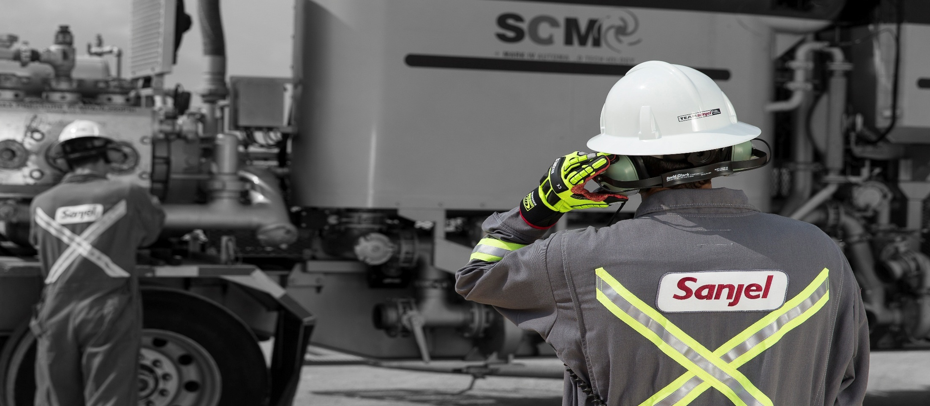
Supervisor one
Presented by: Clayton Beniuk, Trainer
Graham Ford, Trainer
James Gray, Manager Training

Slide 2

Supervisor in TRAINING General introduction
Name
Home base location
Job title
Previous experience
Something that you are proud of in your life

Slide 3
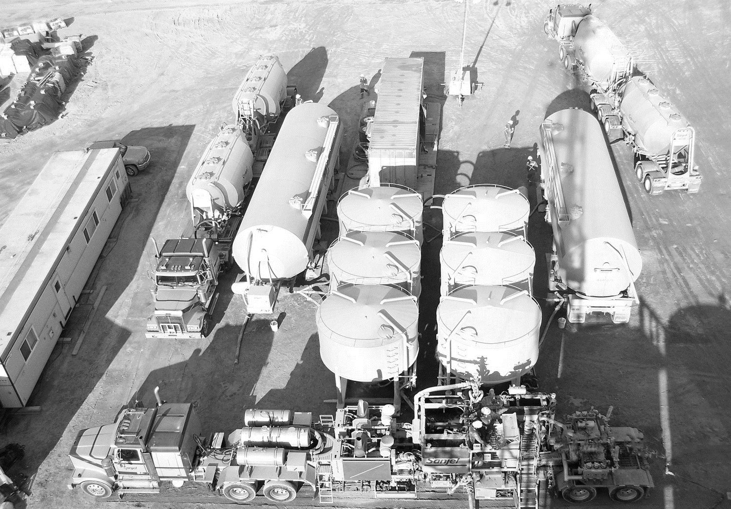
AGENDA
Day 1

Slide 4
AGENDA
Day 2

Slide 5
AGENDA
Day 3

Slide 6
AGENDA
Day 4

Slide 7
AGENDA
Day 5

Slide 8
Supervisor in TRAINING General introduction
Ensure you logged in as on duty at 08:00am!
Ensure if not from RD you are signed in and out at Reception everyday
Shop Code “5-1-2”
Sign in sheets
Breaks and Meals
Group Expectations
Cell phones to be turned off in class – donut rule is in effect, no exceptions
Leave work area tidy at the end of the day, garbage removed, books stacked, chairs pushed in.
No dirty boots or clothing in the classroom
Expect full long days

Slide 9
Supervisor in TRAINING General introduction
Journey Management
Hotels
Breaks and Meals
Breakfast – Continental provided by the hotel
Lunch – Provided by Sanjel at Red Deer Shop
Dinner is available at the hotel. Each employee is authorized to charge a maximum of $25.00 per day (including gratuity) for dinner to their room. No Alcohol is to be included in this amount. Anything over the $25.00 limit will be the responsibility of the employee. Please Note: Employees will not be permitted to claim expenses while attending this course.

Slide 10
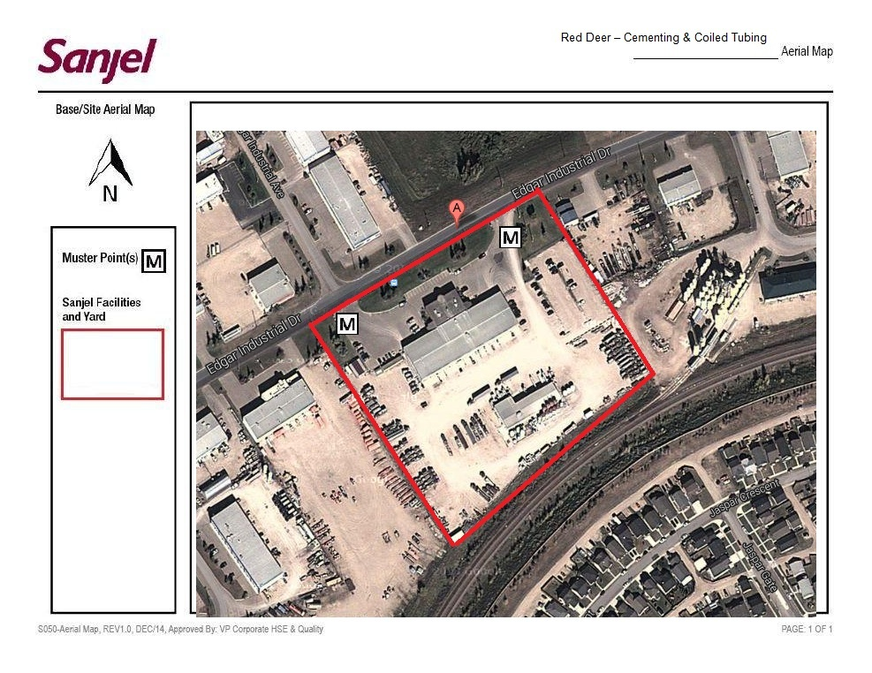
Red Deer Site Orientation aerial view with muster points

Slide 11

Red Deer Site Orientation Building Rules
Smoking area (put butts in can)
PPE must be worn in work areas
Observe walk ways (yellow lines)
Do not enter any shop or work area without being accompanied by a local employee
This is a fully operational facility. Please respect the Red Deer district and help us keep it clean!!

Slide 12
Red Deer Site Orientation Tour
You will now be taken on a physical tour:
Escape routes
Lunchroom
Location of locker rooms
Meeting points for class
Location of shop training area
Restrooms
Muster points
Bring your Site orientation pamphlet and hand in to instructor when complete

Slide 13
Operations career Path New Employee to team leader / Supervisor 4
Employee is hired
Field Hand in Training
Operator 1
Supervisor 1
Bulk Plant Op In Training
Driver 1
Operator 2
Supervisor 2
Specialized Driver In Training
Winch Truck
B-train
Over Dimension
Driver 2
Operator 3
Supervisor 3
Supervisor 4
Team Lead
Traditional Path
Non Traditional Path
Notes:
To be an operator 1, one of the minimum requirements is to have a class 1.
Therefore, all employee must either have a class 1 or go through driver1/2 then considered for the Op 1 position.
→→→
New employee is initially hired as one of the four entry positions and will be supported
Throughout the career by participating in career development plans with direct manager and completing
Training and development requirements as per training matrix
Any newly hired employee will have to participate and complete the Short Service Employee (SSE) program with mentor(s)

Slide 14
Supervisor in TRAINING course evaluation
Student Certification
Attendance all days
Class participation
Quizzes
Final Project
Certification does not expire
Course Weight
Class Participation | 10%
Quiz #1 | 20%
Quiz #2 | 20%
Final Project Practical | 50%
Pass Mark | Min 80%

Slide 15

Supervisor in TRAINING Vision & Mission poster

Slide 16

Supervisor in TRAINING vision & mission
Vision
To be Canada’s Premier Energy Services Company.
Mission
Led by a culture created through Pride by Performance, “Our Company” will build on past learnings with focus on our guiding principles of; Service, Excellence, Integrity, and Teamwork.

Slide 17
Supervisor in TRAINING guiding principles
Guiding principles
Service: We are a “can do” company that makes our customers and co-workers jobs easier.
Excellence: Our company’s core business is operations. The solutions that we provide will be innovative and focused around practical applications that support our jobs being completed “Safely & Perfectly”.
Integrity: We as individuals, and as a result collectively, will act in accordance with honesty, fairness, high ethical standards and the well-being of people foremost.
Teamwork: We are all on the same team and all have individual roles to play within our company. Communication is our unifying force. We will ensure; objectives are clear, individuals are informed as it relates to their role, and results are transparent.

Slide 18
Supervisor in TRAINING unspoken expectations “pride”
Honest
Never tell an known untruth to our customers or our company staff no matter the presumed consequences
Performance
Professional - appearance and demeanor
Flexible – find a way to accomplish our customers needs and desires (can’t do is not in our vocabulary)
Courage
Decision maker – Management and overhead there for a resource but not there to limit your ability to make decisions
Decisions based on logical thought pattern will be supported
Mentor / developer of crew

Slide 19
Cementing corporate standard 7a

Slide 20
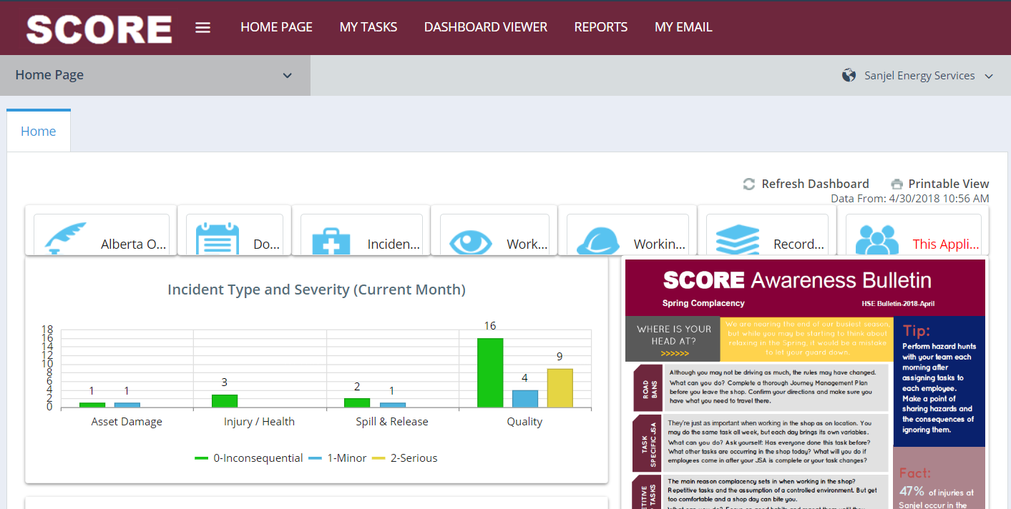
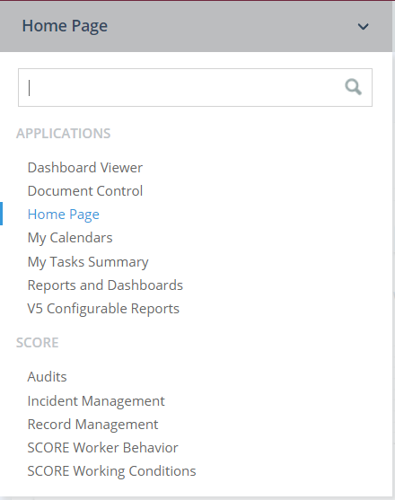
Sanjel corporate standards 07a where to find it

Slide 21
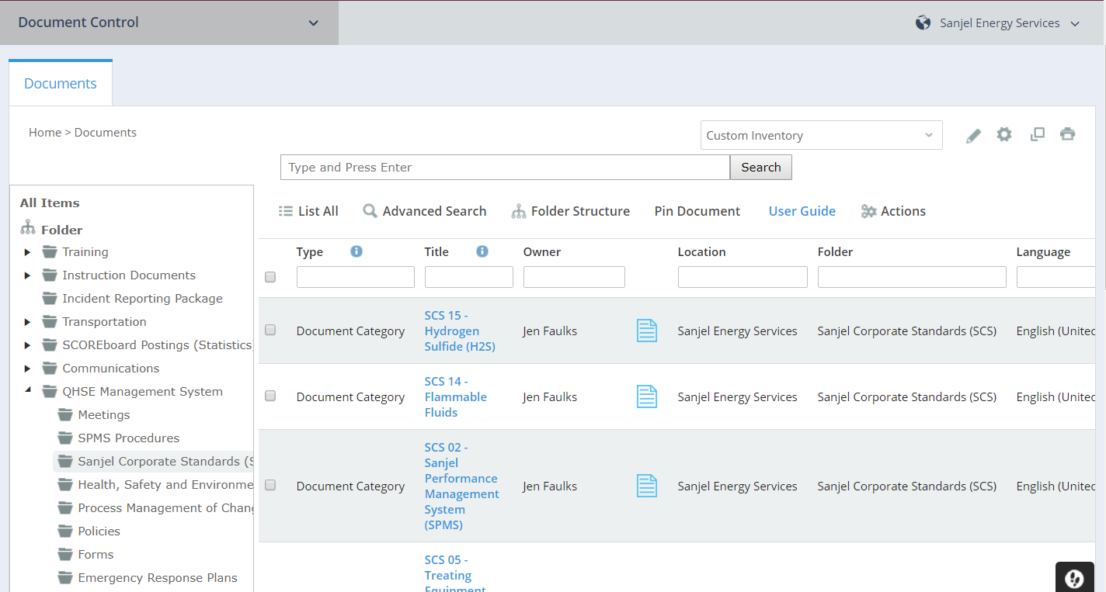
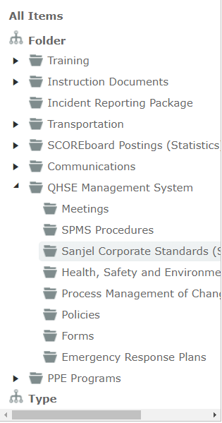
Sanjel corporate standards 07a where to find it

Slide 22
Cementing corporate standard 7a Key Takeaways as supervisor
This is printed in Chapter 2.
Review and comment if it is not working or does not make sense.
Highlight areas below. Can be used as a checklist for job prep – execution
Written so can follow what needs to be done in common order of Operations
Job Design
Departure Meeting
Arrival at Location
Rig in
Pre-job Safety
Execution
Rig Out
Job Documentation

Slide 23
Cementing corporate standard 7a Key Takeaways as supervisor
This is printed in Chapter 2.
The High-Pressure test must be 7 MPa (1000 psi) or 11% above the MATP rounded up to the nearest 5 but never exceeding the Envelope WP (For example if the PRV setting in Sanjel iron is 4 MPa for a conductor barrel the High Pressure Test must not exceed the PRV setting of 4 MPa.)
Pressure tests must be done for Sanjel’s treating line from the pumping unit(s) to the Sanjel valve closest to the client’s equipment.
Sanjel Supervisors shall ensure that, with the co-operation of the client, that all Sanjel Personnel at the wellsite is compliant with this and other applicable standards, procedures, policies, best practices, etc. If unacceptable risks exist the Sanjel Supervisor must take action to mitigate the risks. If unacceptable risks cannot be mitigated or the standard requirements cannot be complied with, the Sanjel Supervisor must terminate the job and notify Sanjel Line Management of the situation to seek an acceptable solution that will allow continuation of the operation.

Slide 24
Cementing corporate standard 7a Key Take a ways as supervisor
This is printed in Chapter 2.
All Sanjel Personnel must review SDS’s for the onsite chemical and must follow the safe handling procedures including PPE requirements outlined in SDS’s to minimize exposure to onsite chemicals. Refer to the SCS for Materials Storage and Handling for SDS compliance information.
Sanjel Personnel may only tap, a pressure vessel that has a pressure differential less than 14.9 psi with a rubber mallet (eg. bulk storage and transport vessels). No pressure vessel will be struck with something harder than a rubber mallet.
Sanjel employees must never operate equipment that does not belong to, is not leased to or is not rented to Sanjel.
Personal cell phone use is not allowed on wellsites as use will distract from assigned duties. This includes pre-job preparation, rig-in, pressure test, pumping operation, and rig-down. Other Client cell phone restrictions may also be in place.

Slide 25
Cementing corporate standard 7a Key Takeaways as supervisor
Review and comment if it is not working or does not make sense, these can be found in SCORE.
HSEP
Hydrogen Sulfide Field Crew Preparations
Working at Heights
Safety Culture, Awareness and Engagement.
Transport Safety
Environmental Impacts and Controls
Incident Reporting, Investigation and Analysis
Weather Conditions and Wildlife Safety
Fire Protection
Permit to Work
Working Alone
Crystalline Silica
Incident Reporting, Investigation and Analysis

Slide 26
Crew briefing jsa & Journey management plan

Slide 27
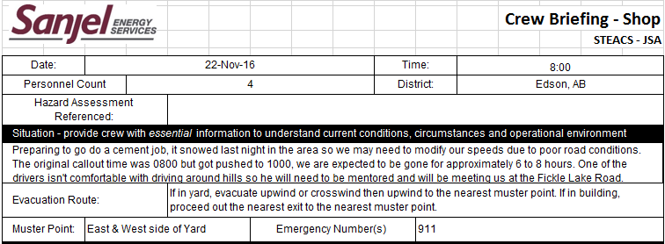
Job Preparation Steacs briefing exercise
Use the call sheet, program, and any other documentation to fill out FRM-HSE-015b form. This paperwork needs to be handed into the district. Paperwork can be found in Chapter 4.
Situation – provide crew with essential information to understand current conditions, circumstances, and operational environment. This section includes evacuation route, muster points, and the emergency numbers to use.

Slide 28
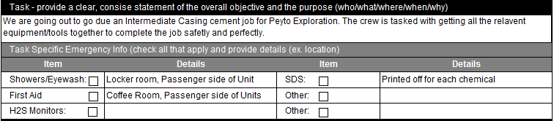
Job Preparation Steacs briefing exercise
Task – provide a clear, concise statement of the overall objective and the purpose of what is expected. This section includes the details and locations of the safety equipment.
Print off the SDS’s for each of the chemicals going to be used and have the locations of the safety equipment in the shop (ie. Shower unit is in the locker room, eyewash station is on the passenger side of all Sanjel units, etc.).

Slide 29
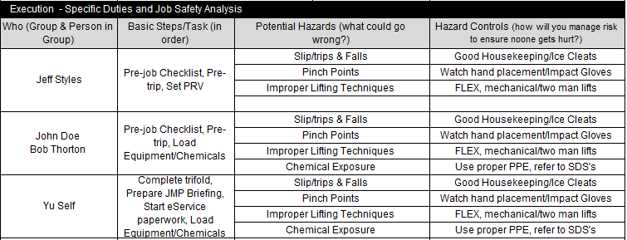
Job Preparation Steacs briefing exercise
Execution – Define the specific duties for each employee, the associated hazards that are identified with that task, and the controls that can be put in place to mitigate the risk.

Slide 30
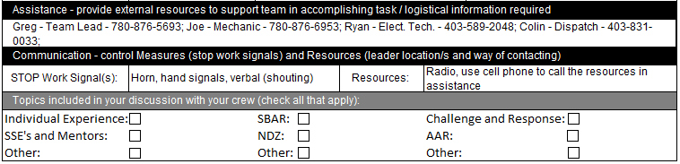
Job Preparation Steacs briefing exercise
Assistance – provide the name, phone number, and title of anyone that you could possibly need to phone in the event of a problem.
Communication – List out all the different ways there are to signal STOP work. The means of communication that will be used to contact people (ie. Cell phone or radio). Lastly, there is a section for topics to mention before leaving the shop (ie. What is the experience level of your crew?, Is there any SSE’s and do they have a mentor?, Does all the employee’s understand the Challenge and Response method? etc.).

Slide 31
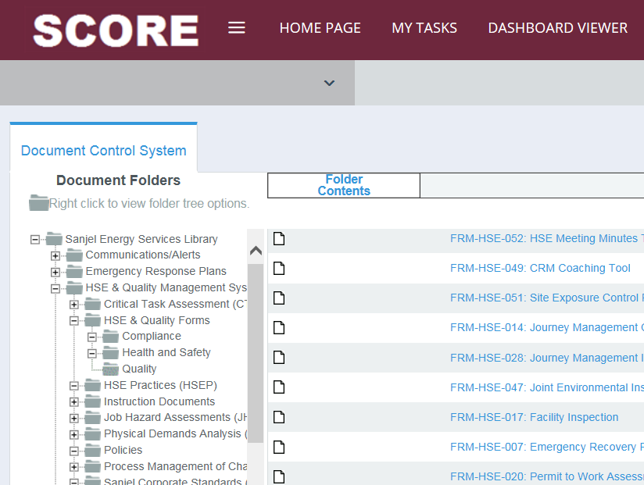
Journey Management demonstration
As per HSEP 010 – Transport Safety
Supervisor (or Journey leader) plan their own trip
Complete a Journey Management Checklist (JMC) FRM-HSE-014 (In SCORE document control)
Complete a High Risk Plan (HRP), when applicable FRM-HSE-013
Refer to RRM to reduce the risk of travel when planning a trip
Hold JMP STEACS briefing to communicate details of the journey
This paperwork needs to be handed into the district

Slide 32
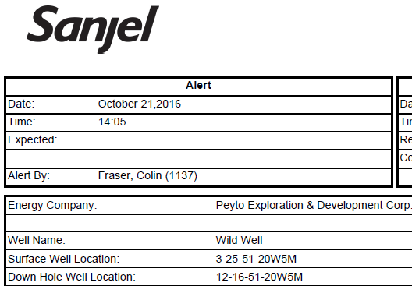
Journey management demonstration
Get LSD from call sheet (surface location)

Slide 33
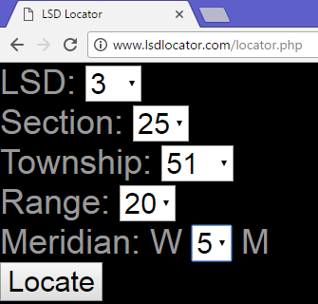
Journey management demonstration
Enter the LSD in the LSD locator website (http://lsdlocator.com/locator.php) and click “Locate”.

Slide 34
Journey management demonstration
This will redirect you to Google Maps with a marker at the coordinates corresponding to the LSD
Click on “Directions”
Type in the starting location e.g. “Sanjel Edson”
The route will now be highlighted on the map
It will not always match the directions on the call sheet, especially on seldom travelled roads
Use Google Maps as a supplement. Call sheet directions come from the OSR

Slide 35
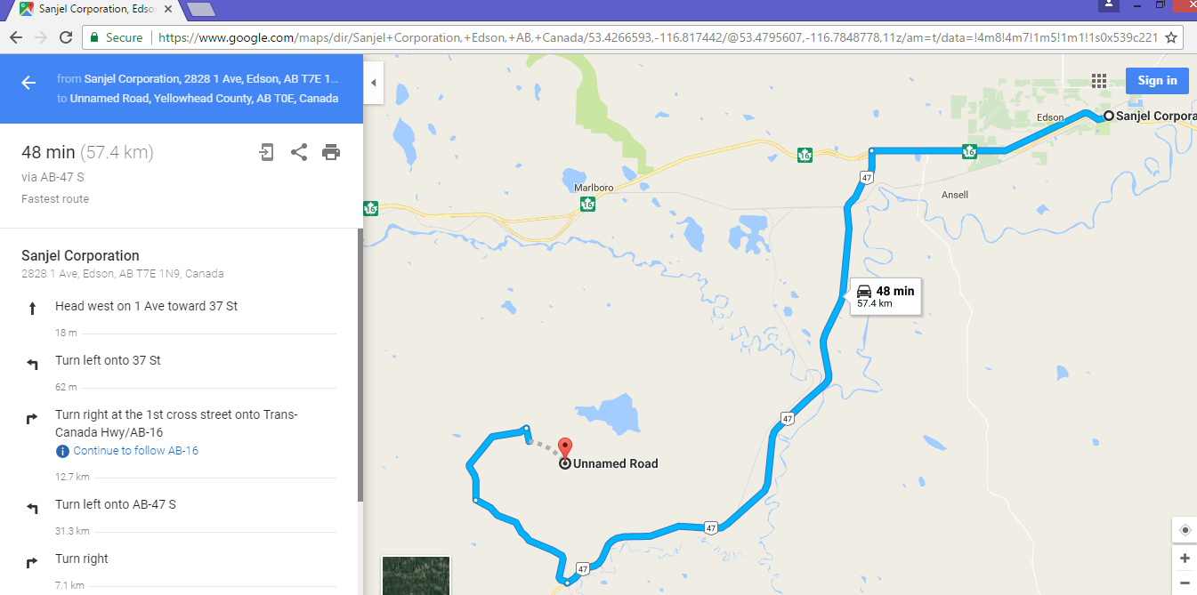
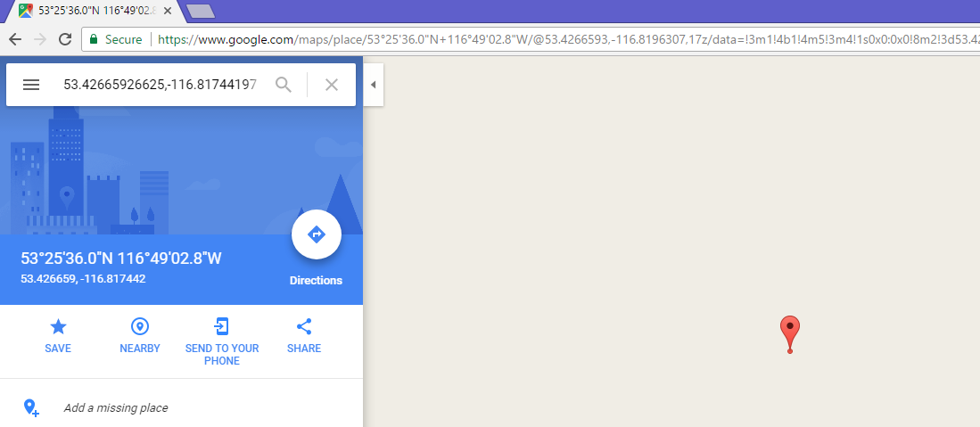
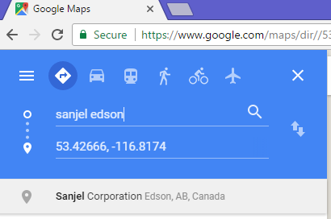
Journey management demonstration

Slide 36
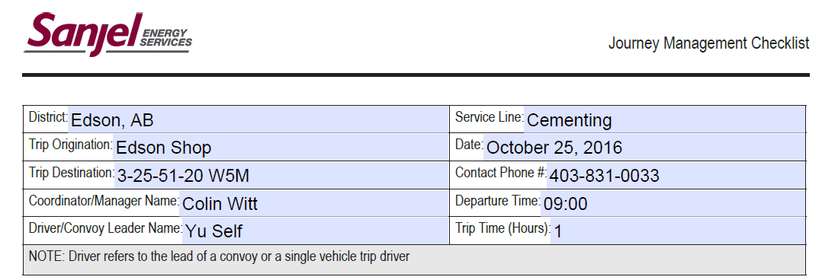
Journey management demonstration
Check the road reports (https://roadreports.ama.ab.ca/)
Check the weather on your route and on location (https://www.theweathernetwork.com)
Fill out FRM-HSE-014 – JMP checklist, make sure that Drivers 1 are placed in the convoy so they can get help if needed.

Slide 37
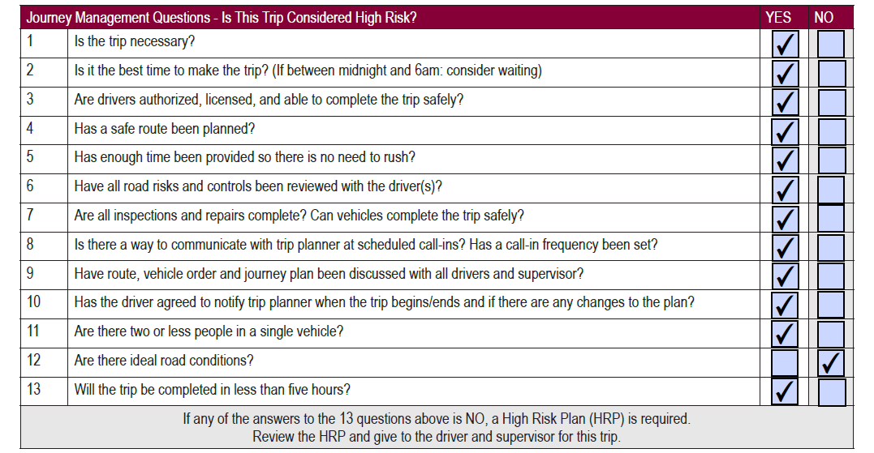
Journey management demonstration
Answer the 13 questions about the trip, as it states below that if a question was answered as NO, then a FRM-HSE-013 Journey Management High Risk Plan needs to be filled out.

Slide 38
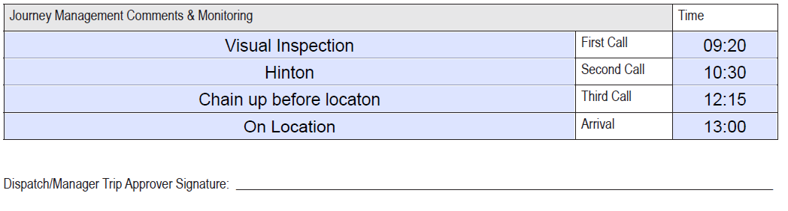
Journey management demonstration
Fill out where the planned stops are and the time that you called in, dispatch or your manager needs to sign the document approving the trip.

Slide 39
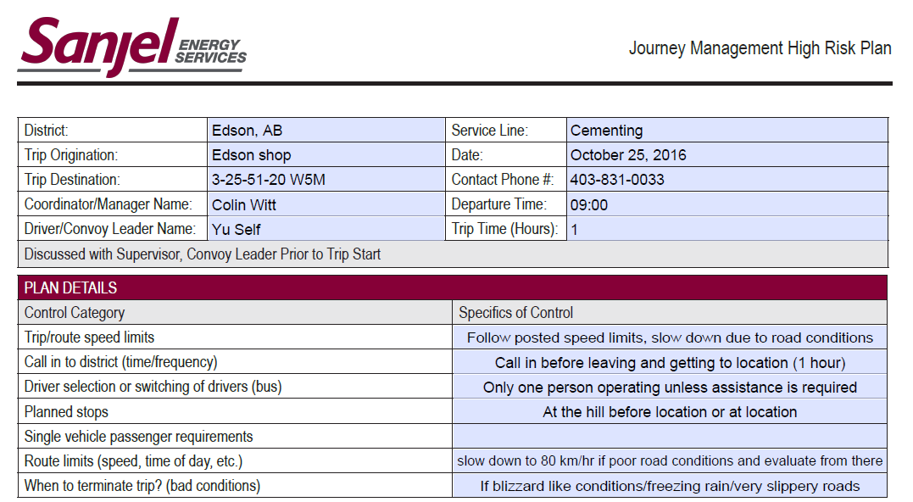
High risk Journey management demonstration
Fill out FRM-HSE-013 – Journey Management High Risk Plan. Specify all the restrictions or conditions that are placed on the trip (ie. Speed limits, when to terminate the trip, planned stops, rules for multi-personnel vehicles, etc.)

Slide 40
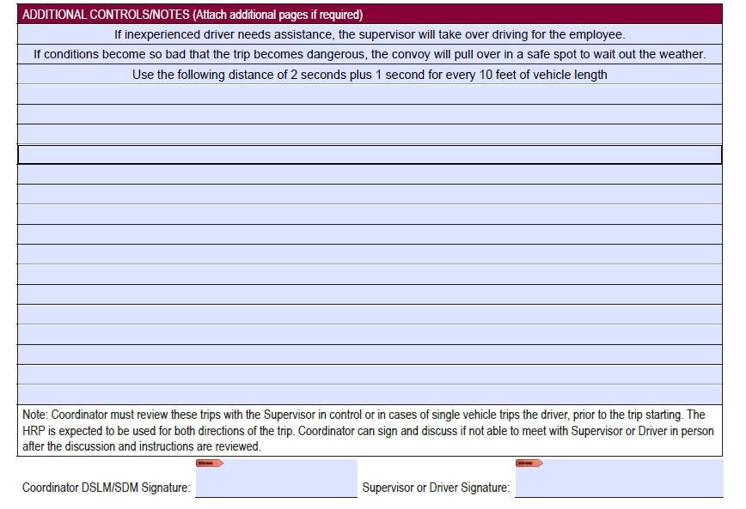
High risk Journey management demonstration
Fill out the additional controls/notes section, this is for guidelines that you don’t have enough room for in the Plan Details section or that don’t fit into any category. The plan must be signed off on by management.

Slide 41
Journey management demonstration
57.4 km to location total
44 km on main roads @ 80 km/h max avg
44 km÷80 km/h = 0.55 h×60 min/h = 33 min
13.4 km on unpaved road @ 50 km/h max avg
13.4 km÷50km/h = 0.27 h×60 min/h = 16 min
Chaining up takes approximately 30 min
Total time = 33 min + 16 min + 30 min = 79 min
Add 15 minutes for each VI performed and additional time for other factors such as chaining up

Slide 42
Journey management imitation
Sanjel in position to get more work from Peyto W5M from a competitor. Next job is at 3-25-051-20 W5M. See call sheet 1067780 in Chapter 5, time now is 1700. Time on location has been changed to 2000hrs. It snowed last night but not snowing now. There is a steep hill into location so stop and chain up at entrance to lease road.
Crew all had 8 hrs since last on duty time
John Doe Driving bulker 746104 from Red Deer – been fighting with wife and does not know roads in Edson well. Unconfident on hills
Bob Thornton Driving Bulk 746105 and coming from Edson with you at shop
Jeff Styles Driving SCMT 445002 from Edson – likes to drink on days off
Yourself in PU 201001
Grab all required paperwork which is in Chapter 5.
In groups fill out FRM-HSE-014 JMC, fill out FRM-HSE-013 JMHRP, and use the computer to plan the route (using sites such as LSD locator).

Slide 43
Hole preparation & pre-flushes and spacers

Slide 44
Hole preparation Drilling Mud
Drilling mud is essential in the construction of a new well
Mud is pumped down the drill pipe, through the bit, and returns to surface via the annulus.
Drilling mud serves many purposes:
Cool and lubricate the drill bit
Remove cuttings and transport them to surface
Creates a filter cake which helps prevent lost circulation
Provides power for downhole tools
Prevent gas kicks

Slide 45
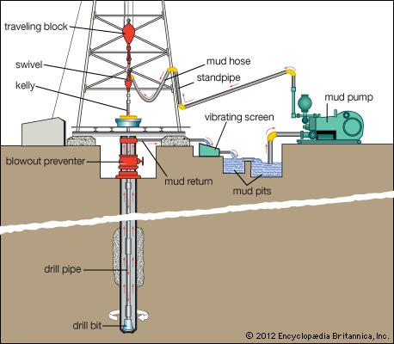
Hole preparation Drilling Mud

Slide 46
Hole preparation Drilling Mud
Drilling mud replaces the weight of the formation by exerting hydrostatic pressure.
The amount of hydrostatic pressure exerted can be controlled by adjusting the mud density.
If the mud is too heavy losses could be induced.
If the mud is too light the well could kick
Density can be altered by using a weighting material like barite or Calcium Carbonate (inert materials that do not alter the chemical properties)

Slide 47
Hole preparation Drilling Mud
Drilling Muds can be separated into 3 main categories
Water-based mud (polymer, gel chem) – most widely used due to lower environmental impact and lower cost.
Oil-based mud (invert) – Reduces torque and can be used in formations that are water sensitive
Synthetic fluids – used when oil based fluids are not allowed due to environmental concerns.

Slide 48
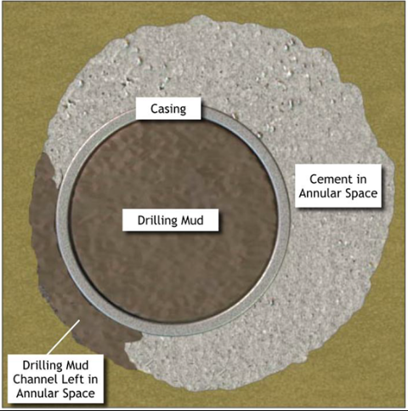
Hole preparation Drilling Mud removal
The efficient removal of drilling mud is the first step in a successful cement job
Drilling mud and cement are incompatible fluids. Cement that mixes with mud will not achieve the desired properties.
Gelled pockets of mud left in the well will provide a path for gas to migrate.
Filter cake left in the well will degrade over time leaving voids, allowing gas to escape.
Cement can channel through unconditioned mud, creating cement stringers and incomplete coverage.

Slide 49
Hole preparation Drilling Mud removal
There are several methods to ensure mud is removed properly prior to a cement job
Mud conditioning/Drilling Practices
Centralization
Mechanical Aid
Spacer Design
Displacement Efficiency

Slide 50

Hole preparation Drilling Mud conditioning
Properly conditioned mud can more easily be removed from the well
Reduce the viscosity of the mud in the wellbore for easier removal.
Marsh funnel Viscosity of 45 to 50 is optimum
Circulate the casing for a period of time (generally set by the client’s head office with recommendations from Sanjel Client Solutions)
This removes pockets of gelled mud and cleans cuttings from the face of the wellbore and the casing

Slide 51
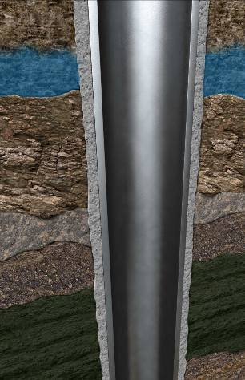
Hole preparation Centralization
If the casing is not centered in the well, fluid will not flow uniformly around it
Mud will take the path of least resistance
Areas of the annulus can remain uncemented
Mud left behind can contaminate the cement
This will lead to poor cement bond and gas channelling

Slide 52

Hole preparation Displacement efficiency
Increased Pumping Rates can aid in mud removal
Higher displacement rates increase the velocity of fluid in the annulus. (Smaller annulus will give higher velocity at the same pump rate)
The higher the velocity, the more energy in the system, which will clean the hole better.
Increased pump rates increase hazards, so this is not a preferred method of mud removal

Slide 53
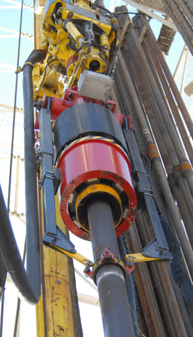
Hole preparation Reciprocation and Rotation
Reciprocating the casing during a cement:
Helps break up pockets of gelled mud
Creates a drag force that assists in mud and cutting removal
Rotating the casing during a cement job:
Helps to centralize casing
Creates a drag force that assists in mud and cutting removal

Slide 54
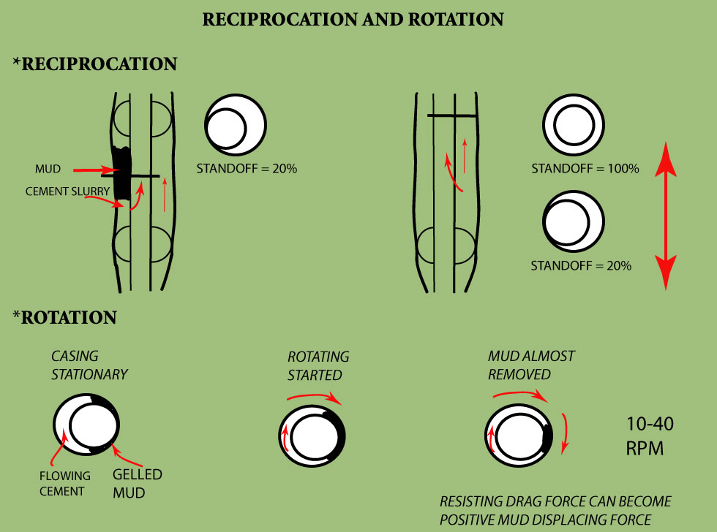
Hole preparation Reciprocation and Rotation

Slide 55
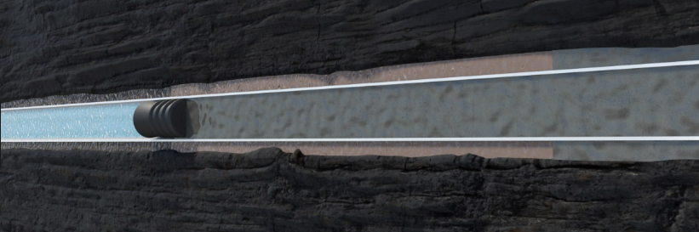
Pre-flushes and Spacers types
Pre-flush - has a chemical purpose
Spacer - more of a physical barrier
Both must
Be compatible with mud and cement slurry
Have desired density and rheological profile for optimal displacement efficiency
Have correct chemistry to clean hole and leave in a water wet state

Slide 56
Pre-flushes and Spacers types
The appropriate preflushes and spacers are key in removing mud and preventing contamination
Preflushes and spacers create a buffer between the mud and the cement, preventing contamination.
Final step in mud removal prior to placing cement
Sanjel recommended height of 150 m of annular height.
Spacer may need to be weighted up with an inert material such as barite or Calcium Carbonate, depending on mud weight. This prevents channeling and ensures that the hydrostatic pressure on the formation remains higher than formation pressure

Slide 57
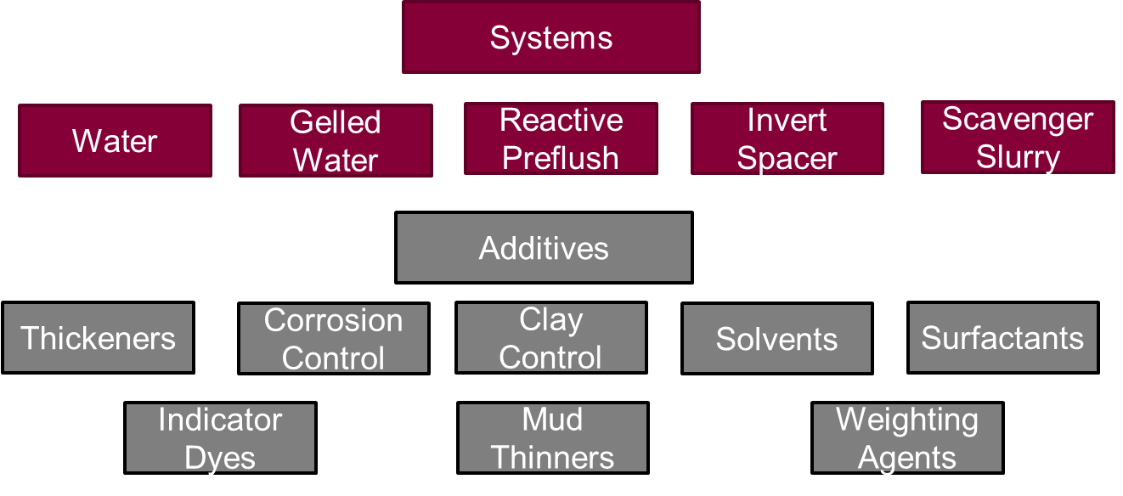
Pre-flushes and Spacers types

Slide 58
Pre-flushes and Spacers types
Preflush and Spacer selection is primarily determined by the type of mud in the well
Water (Preflush)
Most common preflush
Can be used on many job types on wells with water based mud systems.
Can be used solo or as part of a 2 part system (typically with visweep)
Cannot be weighted up
Visweep (Spacer)
Most commonly used spacer
Uses 1 % WG-3L, which increases viscosity
Used for a variety of job types with a water based mud system
Density can be increased with weighting material

Slide 59
Pre-flushes and Spacers types
2 Part System
Invert Preflush (Oil Based)
Pumped on wells with an invert mud system
Made up of base oil with 2% WWS-2L
WWS-2L is a solvent that helps turn the well from “oil wet” to “water wet”
Used as part of a 2 part system with Invert Spacer
Can be weighted up, but requires the use of a viscosifier (IPG-4)
Invert Spacer (Water Based)
Similar to visweep, with the addition of 1% WWS-3L
WWS-3L is a solvent that helps strip oil from wellbore (similar to WWS-2L)
Used in conjunction with Invert Preflush
Density can be increased with weighting material with WG-3L most often

Slide 60
Pre-flushes and Spacers types
Invert Preflush
1m ³ Preflush
960 L Base Oil
10 L IPG-4 Gellant (if needed) - Typically 10-20 L/m³ (made of 50:50 IPG-4A and IPG-4B) 10 L Jugs
30 L WWS-2 L (20 L pails)
Weighting Material if Needed (subtract abs volume from Base oil)

Slide 61
Pre-flushes and Spacers types
Invert Spacer
1m ³ Spacer
980 L Fresh Water (15-25°C)
10 L WG-3L (20 L pails)
10 L WWS-3 L (20 L pails)
Weighting Material if Needed (subtract abs volume from water)

Slide 62
Pre-flushes and Spacers types waterwet max
Water-based product instead of 2 part system needing base fluid
Water
Surfactant (2% - WWS-4L)
Solvent (3% - WWS-2L)
Viscosifier depending on BHCT (WG-3L or WG-6P)
Can be unweighted or weighted with typical weighting agents

Slide 63
Pre-flushes and Spacers types waterwet max
1m ³ Waterwet Max
940 L Fresh Water (15-25°C)
Gellant - Typically 10-15 L/m³ WG-3L or 10-15 kg/m³ WG-6P (As per program)
30 L WWS-2 L (20 L pails)
20 L WWS-4L (20 L Pails)
Weighting Material if Needed (subtract abs volume from water)

Slide 64
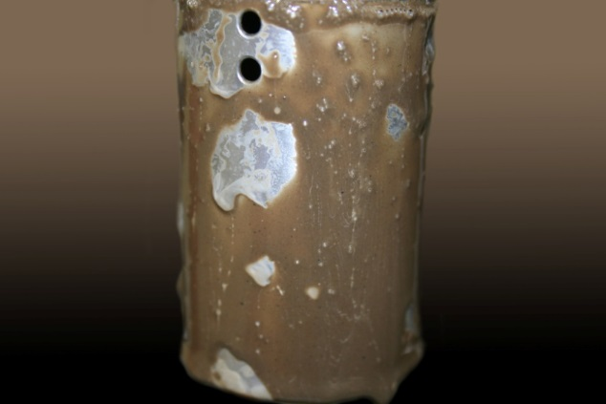
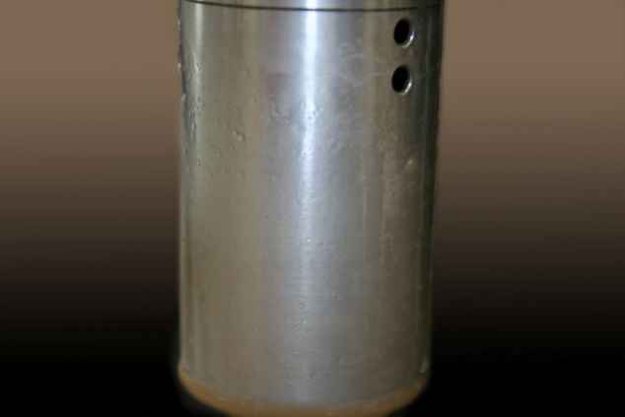
Pre-flushes and Spacers Wettability – Rotor Test
Insert cup with heated mud around cleaned rotor and spin at 100 RPM for 5 minutes
Check with room temp. water for beading
Cover rotor with heated spacer and spin at 100 RPM for 10 minutes
Cover rotor with room temperature water and spin at 100 RPM for 5 minutes
Check rotor for water wet features

Slide 65
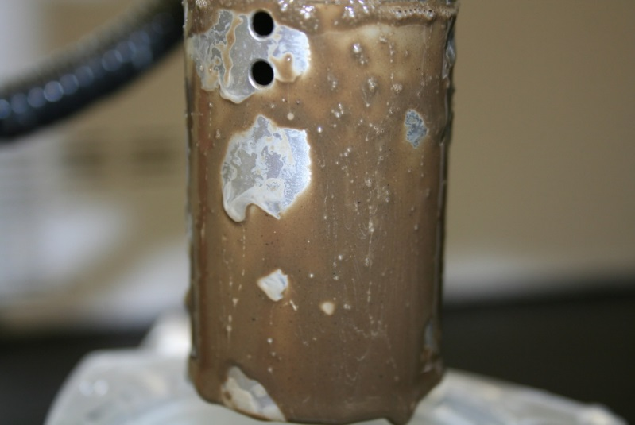
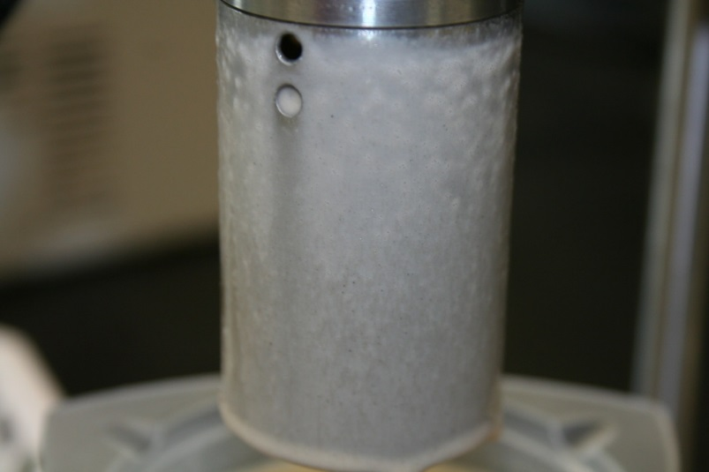
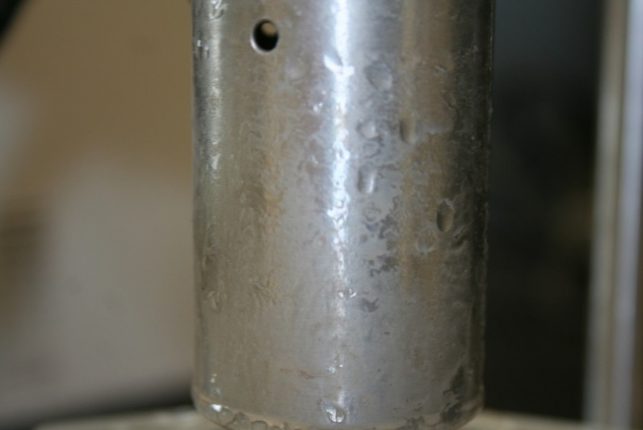
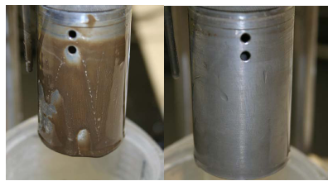
Pre-flushes and Spacers Wettability – Rotor Test
2-Part System
Waterwet Max

Slide 66
Pre-flushes and Spacers types others
SAPP Flush – Provides turbulence easily, thins mud and reacts to loosen mud filter cake
Mud-Flush – Contains mud thinner and water wetting surfactant. Provides turbulence easily, thins mud, and loosens mud filter cake. Leaves pipe and formation water wet for improved bonding
Scavenger Slurry – Diluted cement slurry provides turbulence easily. Suspends fine particles for better transportation to surface, but requires a preflush ahead as it is not compatible with mud.
Well-Seal – A reactive flush used where fallback and mild lost circulation is a problem. Causes cement to gel upon contact. Uses SCA-6

Slide 67
Plugs, plug loading heads & displacement

Slide 68
Preparing for displacement
Inspect all equipment prior to leaving the shop
Check that the manifold is clear of cement and both valves are functioning correctly. Manifolds should have documented pressure tests performed every week.
Check that the tattle tale is functioning properly. The indicator lever should move back and forth with minimal effort. Have a second employee watch the tab inside to ensure it is moving with the outer indicator lever. Grease the tattle tale.
Before (plug still in head)
After (plug has left)

Slide 69
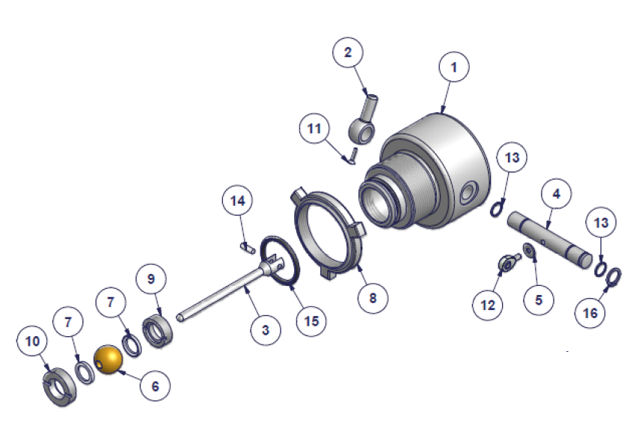
Preparing for displacement
The IRI tattle tail is composed of several moving parts. It is important to grease this component regularly to ensure proper function.
Cement can damage seals and invade the body of the tattle tail, causing it to seize. It can be rebuild with the proper kit from IRI for a fraction of the cost of replacement.

Slide 70
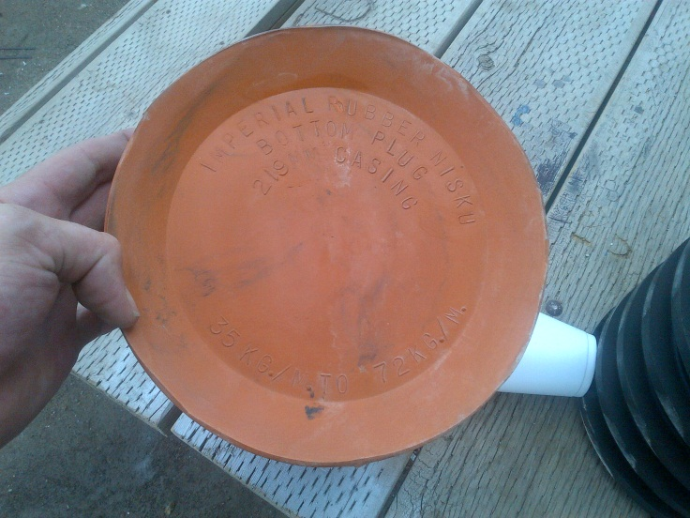
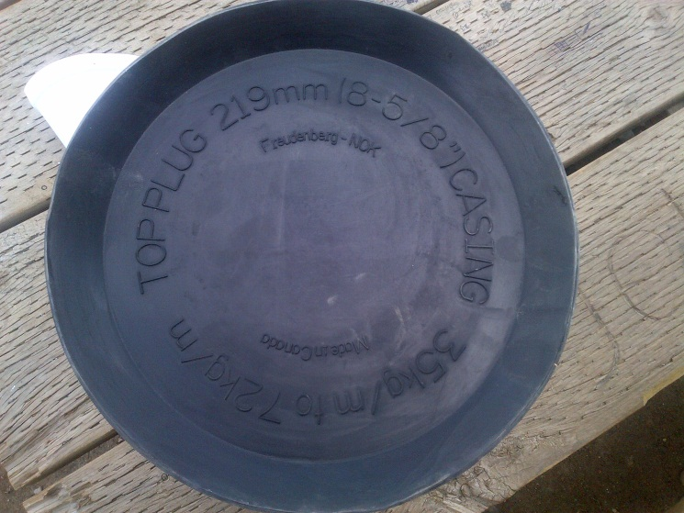
Preparing for displacement
Inspect all equipment prior to leaving the shop
Ensure the head and sub are the proper size for the job. All heads and subs should be labelled with the correct size as per SCS 7A. If not, inform your team lead.
Double check the plug size and ensure proper plugs are grabbed for each job. Check the core of the plug… bottom plugs should feel slightly soft, while top plugs should be completely solid and not flex when pressure is applied (do not rely on color to alone to distinguish top from bottom). Any plugs that do not conform should be quarantined immediately.
Visually check size: DO NOT ASSUME
Check core

Slide 71
Preparing for displacement
Confirm all volumes with the OSR
Total casing length
Casing size
Casing weight
Top of float
Calculate casing volume
V(m3) = Depth to float (m) x casing capacity (m3/m)
If numbers do not match with OSR
Double check depth
Double check capacity factor

Slide 72
Preparing for displacement
Calculate expected bump pressure:
Calculate Hydrostatic differential
Inquire with driller prior to cement job and find out their circulating pressure. This is the friction pressure, at their current pump rate.
Ask the driller to slow their circulating rate to your planned bump rate (0.5 m3/min) This should be close to friction pressure prior to plug bump.
Add HP and FP to accurately estimate bump pressure
Pressure should steadily climb to this value until plug bump.
If pressure starts to drop while you are pumping:
You have over displaced
The casing has failed

Slide 73
Loading the Plug loading head
Load the plug loading head in the presence of the OSR. The order for loading the head is:
Position the head so the pin can be pulled and the cap removed and re-installed (accomplished easily on PLH transport skid, or in a standing upright position)
Remove the top cap and inspect the inside of head. Confirm that the pin is all the way IN.
Check the top cap for damage to threads, lifting device, or O-rings. Spare O-rings must be brought on every job.
Pull the pin. Count the number of turns to fully retract the pin. Write it down and inform OSR. Check inside the head to make sure the pin is fully extracted.
Lubricate the pin with grease and screw it back into the head, double checking the number of turns. Visually check to ensure the pin is in.

Slide 74
Loading the Plug loading head - Cont.
Confirm that the tattle tail is functioning and in the proper position.
Insert the top plug into the PLH, and push it down until it is below the top port of the head. Make sure to inspect the plug prior to loading.
Install the top cap and hammer it tight.
Make sure to follow the correct Lock Out Tag Out proceeds once the head is installed on the casing. Lock the valves and pin in the correct orientation before proceeding on with the job.

Slide 75
Preparing for displacement
Have your operator check his totalizer for accuracy. Circulate from one tank to the other (2 m³) and check for variance.
Note how much fresh water is available. Subtract pre-flush and mix water requirements, this should be your water available for displacement. Double check once finished mixing, accounting for the water already in the displacement tanks.
Calculate the shoe track volume. This will give you an indication of how much “over” you can pump before creating a wet shoe.
NOTE: Sanjel does not make the decision to pump over calculated displacement. MOC process must be followed, and OSR must make the final decision.

Slide 76
Dropping the plug
In order to ensure the plug is successfully launched on each job, the following steps must be followed:
Ensure both pumps are shut down, operator should clearly communicate this through 2-way radio. Confirm by using the “Challenge and Response” communication method:
Supervisor: “Shut down both bumps and disengage pressurizer”
Operator: “Copy, both pumps are out and pressurizer is shut down”
Pull the Lock Out Tag Out (LOTO) cable out of the manifold valves and pin.
If pumping out the lines, close both manifold valves and open the pump out Tee. Put the LOTO cable back through the valves and pin. Proceed to pump out lines.
Confirm tattle tale position (should be in the “before” position)

Slide 77
Dropping the plug
Spin out the pin, counting the number of turns to confirm that it has been retracted all the way. Keep an eye on the tattle tale as the hydrostatic pressure may cause the plug to leave the head as soon as the pin is pulled.
Open the top valve on the manifold. Ensure bottom valve and pump out line are closed.
Confirm that operator has reset totalizers before beginning displacement.
Communicate to operator that the pin is pulled, the top valve is open, and the bottom valve is closed. Indicate for him/her to engage pressurizer. Watch tattle tale if plug has not left the head yet.
Once the operator has established flow with the pressurizer, communicate for them to engage triplex pumps.
Confirm that the plug has left the head with the tattle tale.
After 2 m³ have been pumped, open the bottom valve and screw the pin into the original position.

Slide 78
Displacing
Ensure there is enough water available in water source(s) before starting. Confirm and record the starting volume.
Check valve configuration to ensure fluid is moving directly from the displacement tanks, to the pressurizer, then to the triplex pumps.
For any displacement volume greater than 20 m³ or rates >1 m³/min there must be two Sanjel personnel on the pumper to count tanks as per SCS 7A
Reset totalizers on HMI/SAM.
Mark the starting tank. Count tanks using the provided washers. The second employee should keep track on paper.
Ensure to fill the tanks fully, leaving even a few liters below the stick can add up over the course of a large displacement

Slide 79
Displacing
Drain the tank completely before switching tanks, for the same reason as above.
Continuously monitor totalizers and compare with gauged tank volume pumped.
Pressure should be steadily rising throughout displacement until the moment of plug bump.
Slow down for the last 1 m³
When plug lands at the bottom of the casing, increase the pressure by 3500 kPa and put the pumps in neutral.

Slide 80
Did not bump
If all above procedures have been followed and the plug still did not bump:
Inform OSR
Double check numbers and re-confirm all calculations. Have a 3rd party perform the calculations (tool hand, tool push)
Ensure PLH pin has been completely retracted and manifold valves are in correct position.
Check your FDAS chart, and do a time vs rate calculation:
1 m³/min for 30 min = 30 m³
Check source tanks to see if:
Volume(remaining)= Volume(starting) – Volume(displacement)
Bleed back line pressure and record volume returned to tanks.

Slide 81
Did not bump - MOC
If the OSR wishes to continue displacing, advise him of:
The full shoe track volume
Aeration factor
Any other errors found during double checks
The MOC process must be initiated prior to continuing operations

Slide 82
Technical data handbook

Slide 83

Technical data handbook Sanjel Handbook

Slide 84
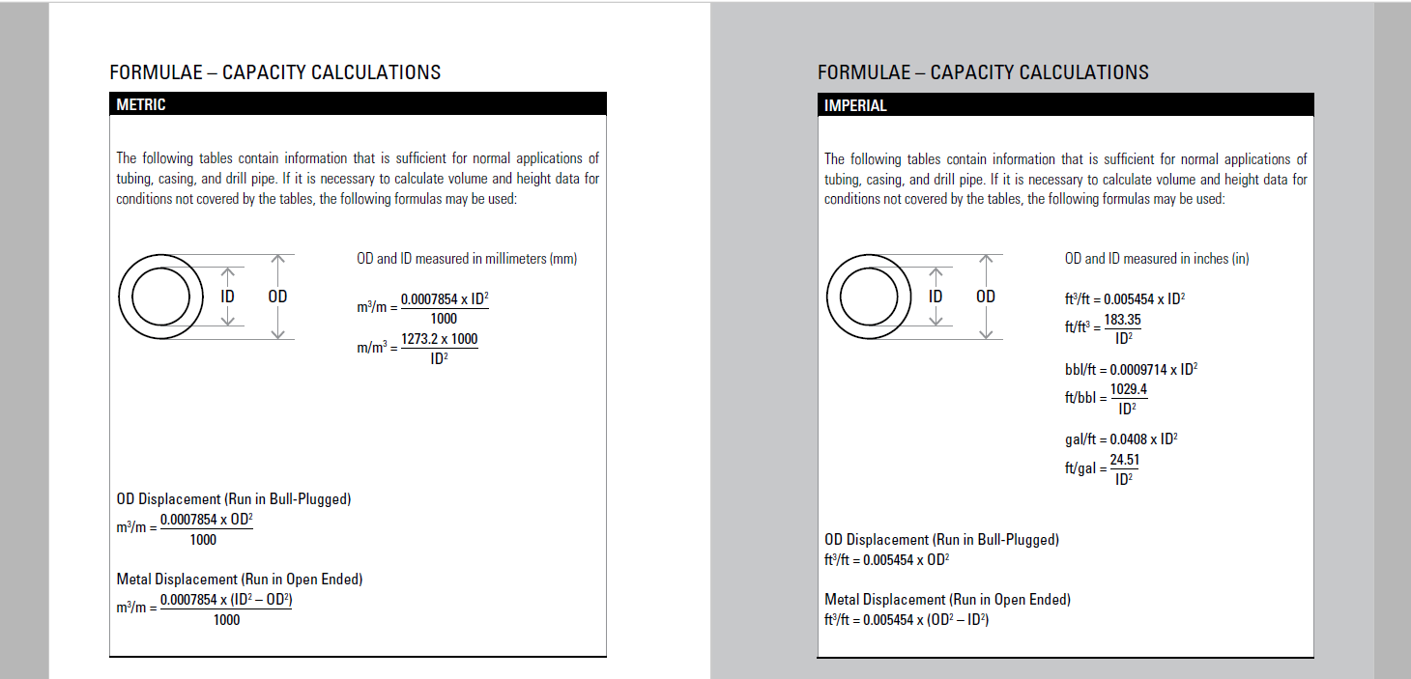
Technical data handbook Sanjel Handbook
Metric:
Imperial:

Slide 85
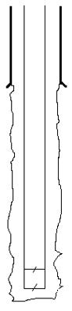
Technical data handbook Capacity definitions
Capacity: The volume contained in a specified length of pipe, open hole, or annulus. Primarily measured in m³/m.
Casing Annular Capacity
Open Hole Annular Capacity
Casing Capacity

Slide 86
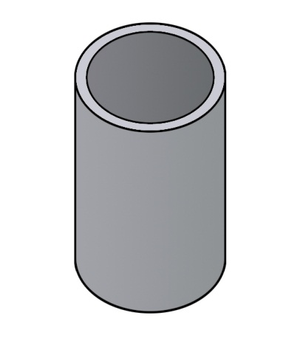
Technical data handbook Capacity definitions
Outer Diameter: A straight line that passes through the center of a circle or pipe with both its ends on the outside of the pipe. This is denoted as “OD”. This is measured in millimeters or inches.
Outer
Diameter

Slide 87
Technical data handbook Capacity definitions
Inside Diameter: A straight line that passes through the center of a circle or pipe with both its ends on the inside of the pipe. This is denoted as “ID”. This is measured in millimeters or inches.
Inner
Diameter

Slide 88
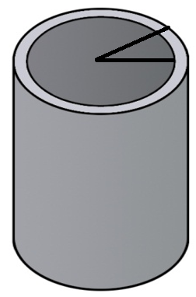
Technical data handbook Capacity definitions
Radius: The distance from the center of a circle or pipe, in a straight line, to its edge. The radius is half of the diameter and is measured in millimeters or inches
Radius (OD)
Radius (ID)

Slide 89
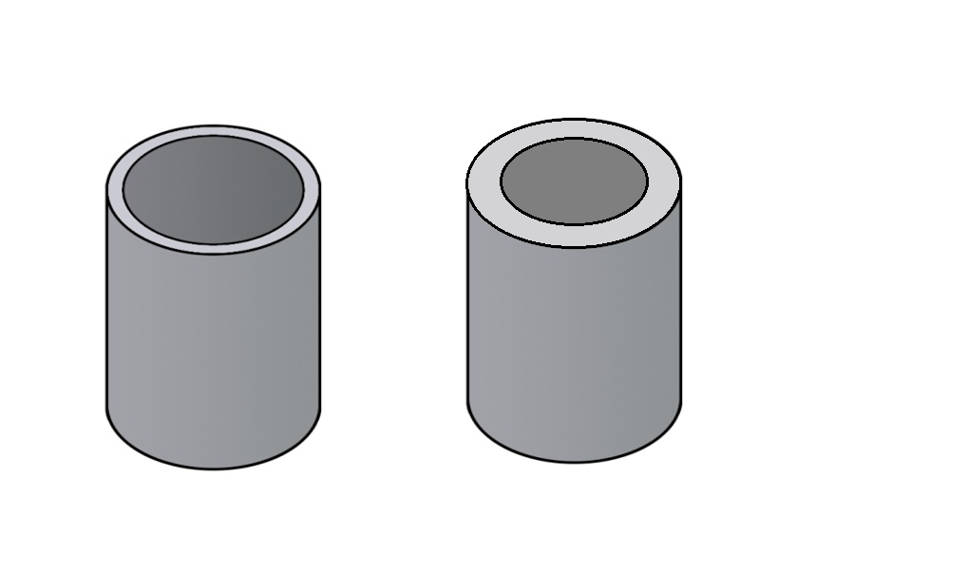
Technical data handbook Capacity definitions
Pipe Weight: The weight of a pipe per unit of length. The heavier the pipe, the thicker the wall, and subsequently smaller the capacity.

Slide 90
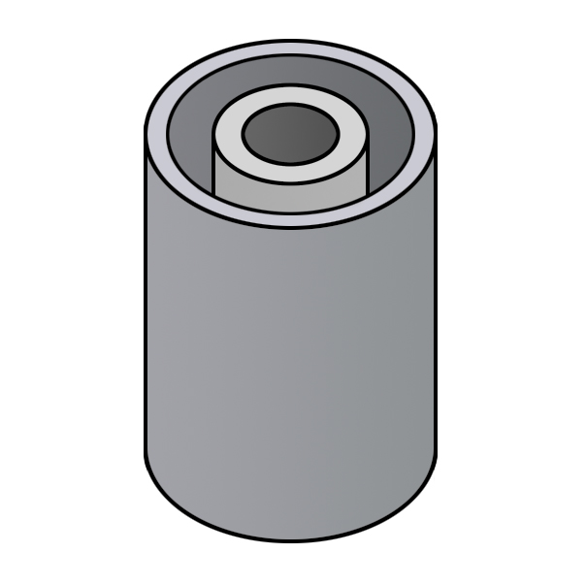
Technical data handbook Capacity definitions
Annulus: The spacing between two strings of pipe (one inside the other) or between the pipe and wall of an open hole.
Annulus

Slide 91
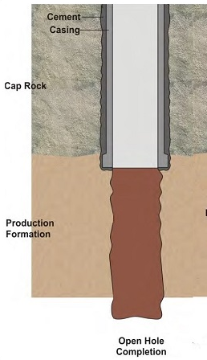
Technical data handbook Capacity definitions
Open Hole: The hole created when a drilling rig bores through the formation. The size of the open hole will be determined by the size of the drill bit selected. This is measured in millimeters.

Slide 92
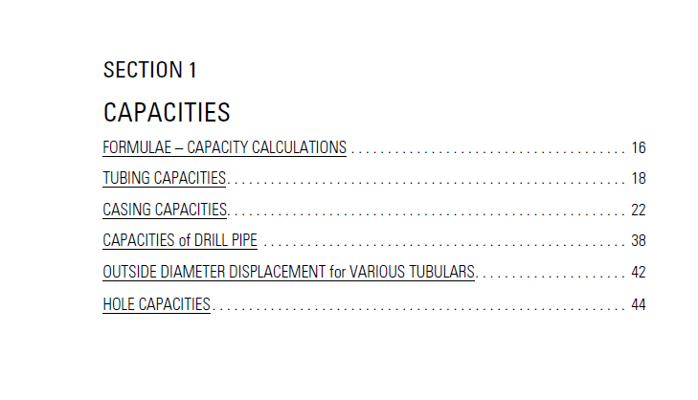
Technical data handbook handbook-Capacity
Section 1 of the handbook contains capacities of various sizes and types of pipe.

Slide 93
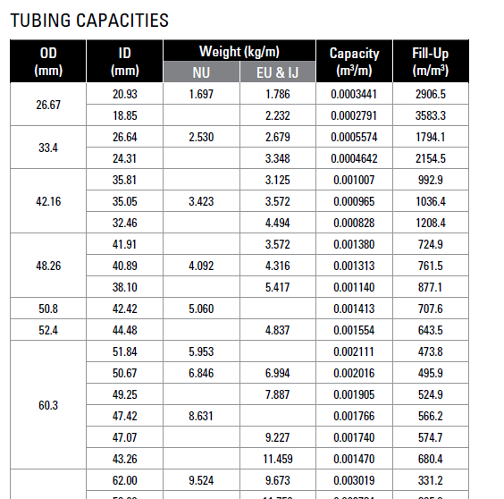
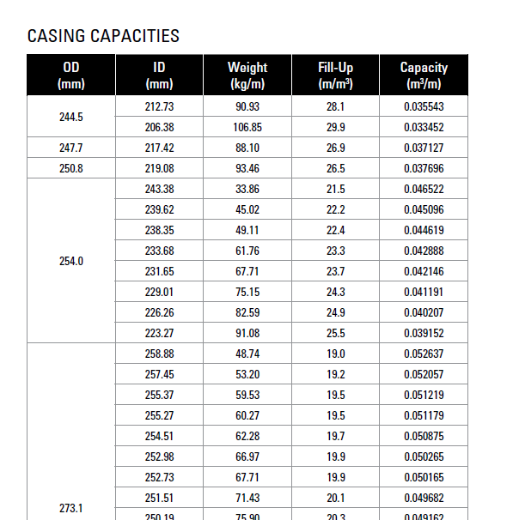
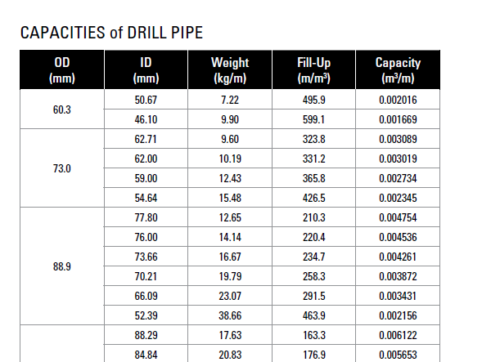
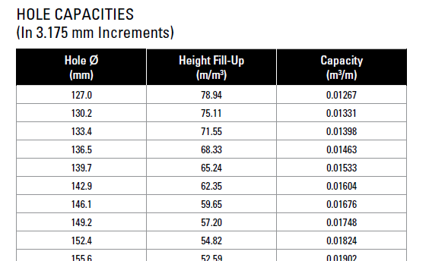
Technical data handbook handbook-Capacity

Slide 94

Find the capacity factor of 114.3 mm casing that weighs 14.14 kg/m.
Handbook Section 1, Page 22
The capacity is 0.008477 m³/m

Slide 95
Example 1
Calculate the volume of 2000 m of 73.0 mm, 14.1 kg/m EU tubing.
Find the page with 73 mm tubing (page 18)
Find the row with 14.1 kg/m
Locate the capacity number (0.002441 m³/m)
Depth x capacity = volume
2000 m x 0.002441 m³/m = 4.9 m³

Slide 96
Example 2
Calculate the volume of 615 m of 244.5 mm, 53.57 kg/m casing.
Check the casing capacities section for 244.5 mm (page 30)
Find 53.57 kg/m in the weight column.
Locate the capacity number in the right column (0.040325 m³/m)
Depth x capacity = volume
615 m x 0.040325 m³/m = 24.8 m³

Slide 97
Example 3
Calculate the volume of 2700 m of 222.3 mm of open hole.
Find hole capacities in Section 1 (pages 44-50)
Locate the 222.3 mm hole size
Record the capacity number (0.03881 m³/m)
Depth x capacity = volume
2700 m x 0.03881 m³/m = 104.8 m³

Slide 98
Capacity calculations
How many cubic meters of H₂0 would it take to fill 2000 m of 177.8 mm , 35.72 kg/m casing?
2000 m x 0.020341 m³/m = 40.7 m³
What is the capacity in litres of 900m 73mm, 9.67 kg/m tubing?
900 m x 0.003019 m³/m = 2.7 m³ x 1000 L/m³ = 2700 L
What is the volume of mud required (in m³) to fill 3200m of 101.6mm, 20.83 kg/m drill pipe?
3200 m x 0.005653 m³/m = 18.1 m³
What is the capacity of a 480 m hole drilled with a 254 mm drill bit?
480 m x 0.05067 m³/m = 24.3 m³

Slide 99
Calculating Height
You can also find the height of a given amount of fluid using the capacity numbers
How many meters of 73 mm, 9.67 kg/m tubing would 1.0 m³ of acid fill up?
Find the 73 mm tubing capacities section on page 18.
Locate the correct weight, 9.67 kg/m (in the EU & IJ column)
Record the capacity number – 0.003019 m³/m
Volume ÷ capacity = height (depth)
1.0 m³ ÷ 0.003019 m³/m = 331.2 m

Slide 100
MORE Capacity calculations
On a surface casing job, the consultant forgot to run a float assembly. He has asked you to short the displacement by 50 m. He is running 193.7 mm, 44.2 kg casing to a depth of 426 m. What is the displacement volume going to be?
426 m – 50 = 376 m x 0.023951 m³/m = 9.0 m³
On an intermediate job, you do not bump the plug. After you go through your checks you determine that your operator missed a tank and has under displaced by 2.0 m³. The OSR is pissed, and wants to know how many meters of cement is left in the casing. Casing is 177.8 mm 50.15 kg/m³. Where is the cement top if the float was at 1812 m?
2.0 m³ ÷ 0.018535 m³/m = 107.9 m
1812 m – 107.9 m = 1704.1 m

Slide 101
MORE Capacity calculations
You are asked to place 1.0 m³ of acid into 435 m of 60.3 mm 5.95 kg/m (NU) tubing. Will it fit?
1.0 m³ ÷ 0.002111 m³/m = 473.7 m
How much acid will be left over on the truck?
435 m x 0.002111 m³/m = 0.9 m³
1.0 m³ - 0.9 m³ = 0.1 m³ or 100 L
No it will not fit

Slide 102

Handbook – Annular Capacities
Section 2 of the handbook contains the annular capacities of pipe inside of other pipe and open hole:

Slide 103

What is the annular capacity factor of 956m of 73mm tubing inside 114.3mm, 14.14 kg/m casing?
Handbook section 2 page 118
The annular capacity is 0.0043 m³/m
Smaller Pipe

Slide 104
Example 1
Calculate the annular volume of 2763 m of 60.3 mm tubing inside of 114.3 mm 14.14 kg/m casing.
Find the page(s) with 60.3 mm pipe on the TOP of the page. (pages 110-116)
Find the page with 114.3 mm pipe. (page 110)
In the row with 14.14 kg/m, locate the annular capacity number.
0.0056 m³/m
Locate the capacity number
Depth x capacity = volume
2763 m x 0.0056 m³/m = 15.5 m³

Slide 105
Example 2
How much cement is required to fill the annulus of 330 m of 219.1 mm casing inside 311.2 mm Open Hole
Find the page(s) with 219.1 mm pipe on the TOP of the page. (pages 224-234)
Find the page with 311.2 mm OH
Locate the capacity number (0.0384 m³/m)
Depth x capacity = volume
330 m x 0.0384 m³/m = 12.7 m³

Slide 106
Annular capacity - Excess
Clients typically request more cement than the actual capacity of the well. This is to account for washouts, lost circulation zones, and irregularities in the well created by the drilling process. This is referred to as excess.
Clients will usually guess high. Any extra cement will be seen at surface. These are Cement Returns.
Excess is calculated as follows
Volume + excess factor = total volume

Slide 107
Example 3
Calculate the cement requirements for a 812 m well drilled with a 222.3 mm drill bit. Casing is 177.8 mm and the OSR has requested 40% excess.
Find the annular capacity for 177.8 mm inside 222.3 mm OH.
0.0140 m³/m
Calculate the volume of the annulus.
812 m x 0.014 m³/m = 11.4 m³
Add the excess to the calculated volume:
11.4 m³ + 40% = 11.4 m³ x 1.40 = 16.0 m³

Slide 108
Annular capacity calculations
How much slurry would you need to fill the annulus of 305m of 219.1 mm casing inside of 311.2 mm open hole?
305m x 0.0384 m³/m = 11.7 m³
What is the annular capacity of 612 m of 139.7 mm casing inside of 244.5 mm, 53.57 kg/m casing?
612 m x 0.025 m³/m = 15.3 m³

Slide 109
Annular capacity calculations
How much slurry would be required if the consultant ordered 35% excess for a job that was 1865 m deep, 200.0 mm OH, with 139.7 mm casing?
1865 m x 0.0161 m³/m = 30.0 m³
30.0 m³ x 1.35 = 40.5 m³
Under perfect well conditions, how much cement would you expect to receive to surface?
40.5 m³ - 30.0 m³ = 10.5 m³

Slide 110
More Annular capacity calculations
How many meters would 4 m³ of visweep cover in the annulus between 158.8 mm OH and 114.3 mm casing?
4.0 m³ ÷ 0.0095 m³/m = 421.1 m
You are watching for cement returns on a cement job. When your operator bumps the plug, you have only seen a total of 1 m³ of preflush. You pumped at total of 6 m³. How far down can you tell the OSR to expect to find the cement top if the annulus is 177.8 mm casing inside 244.5 mm, 48.07 kg/m casing?
6.0 m³ - 1.0 m³ = 5.0 m³ ÷ 0.0162 m³/m = 308.6 m

Slide 111

Handbook – Pipe Strengths and dimensions

Slide 112
Pipe Strengths
There are 3 main considerations in pipe strength:
Internal Yield Pressure: The pressure (MPa) that will “burst” or explode a pipe from the inside.
Collapse Pressure: The pressure from the outside that will cause a pipe to collapse or “implode”.
Joint Yield Pressure: The amount of force (daN or decanewtons) exerted along the length of the pipe joint that will cause it to separate or come apart (the joint being the weakest part of the string).

Slide 113
Pipe Strengths
The properties of the pipe that determine it’s strength are:
Pipe weight: Heavier pipe has thicker walls, therefore can stand up to higher pressure.
Thread Type: The connections are the weakest points in a string of pipe (in general). Different thread types have different joint yields.
Pipe Grade: Refers to the quality of steel that the pipe was made out of, and has no affect on the weight or dimensions of the pipe, but will affect the pressure it can withstand

Slide 114

Pipe Strengths
Find the burst and collapse pressure for 177.8 mm, 34.23 kg/m, C-95 casing
Handbook Section 3 page 336

Slide 115
Pipe Strengths
Sanjel uses 80% of the listed value. This is a safety factor to ensure maximum pressure is not reached.
What value would Sanjel use for the maximum pressure on the previous slide?
Burst: 52 MPa x 0.8 = 41.6 MPa
Collapse: 29 MPa x 0.8 = 23.2 MPa

Slide 116
Pipe Strength Questions
Based on a maximum of 80% of Casing burst, what is the maximum you could set your electronic pressure trip to on a job with 219.1 mm casing, 35.72 kg/m J-55?
Burst: 20 MPa x 0.8 = 16 MPa
You are asked to put pressure on the annulus to test a packer. OSR asks for 25 MPa. The casing is 177.8 mm, 38.69 kg/m J-55. What would you tell the OSR?
Collapse: 30 MPa x 0.8 = 24 MPa
Tell the OSR the highest you can go is 24 MPa.

Slide 117

Find the density, mix water, and yield factors for Thermal 40 (metric)
Handbook section 6, page 566
Density: 1885 kg/m³
Mix Water: 0.41 m³/t
Yield: 0.75 m³/t

Slide 118
Homework Day 1 Review all day’s material Read Ch 2 – SCS 7A Cementing, CH 25 - 27 Sign out !

Slide 119
Cement calculations
NOTE: For Cement Properties, use the charts in Chapter 6 of the Technical Handbook or Chapter 7 of the SIT binder. During a job refer to the program.
How many litres of water would it take to mix 15 t of 0-1-0 G?
15 t x 0.44 m³/t = 6.6 m³ x 1000 L/m³ = 6600 L
How many m³ of slurry could be mixed with 29 t of 1-1-2?
29 t x 0.96 m³/t = 27.8 m³
How many tonnes of 1-1-6 would be needed to make 45 m³ of slurry?
45 m³ ÷ 1.18 m³/t = 38.1 t

Slide 120
Cement calculations
How many tonne of 0-1-0 G would be needed to make 40 m³ of slurry?
40 m³ ÷ 0.76 m³/t = 52.6 t
How many cubic meters of water would be needed in the above question?
52.6 t x 0.44 m³/t = 23.1 m³

Slide 121


Hydrostatic Pressure
Hydrostatic Pressure is the pressure exerted by a column of fluid at the bottom of that column!!
The amount of pressure will depend on 2 factors:
The height of the column of fluid
The density of the fluid
The formula to calculate hydrostatic pressure is:
HP = depth x density x gravity constant
Gravity = 0.00981

Slide 122
Hydrostatic Pressure
Calculate the following hydrostatic pressures.
What is the hydrostatic pressure at the bottom of a 600 m string of casing containing 960 kg/m³ drilling mud?
HP = 600 m x 960 kg/m³ x 0.00981 = 5650.6 kPa
How much pressure will a 1800 m column of 1400 kg/m3 cement put on the formation?
HP = 1800 m x 1400 kg/m³ x 0.00981 = 24721.2 kPa

Slide 123

Hydrostatic Differential
Hydrostatic Differential is the difference in the hydrostatic pressure between 2 columns of fluid in the same well (annulus and tubular)
The pressure will try to equalize itself by “u-tubing”
Hydrostatic pressure that needs to be overcome to move fluid; this is what creates most of the pressure we see on our gauges.

Slide 124
Hydrostatic Differential
Calculate the following hydrostatic differential
What is the hydrostatic differential in a well that is 1580 m deep, with 1901 kg/m³ cement in the annulus and 1000 kg/m³ water in the casing?
HP(out) = 1580 m x 1901 kg/m³ x 0.00981 = 29465 kPa
HP(in) = 1580 m x 1000 kg/m³ x 0.00981 = 15500 kPa
HP(diff) = 29465 kPa – 15500 kPa = 13965 kPa
If we open our return line on the pumper, which way will the fluid go?
How much pressure will it take to start circulating this well?

Slide 125
pressure testing Methodology

Slide 126
Key Definitions
MATP = Maximum Anticipated Treating Pressure
= Hydrostatic Pressure Differential + Friction + 3.5MPa Plug Bump Overpressure
OEM Working Pressure
Original Equipment Manufacturer’s continuous duty working pressure
Envelope
The combination of several elements that will be exposed to fluid and pressure (e.g. all Sanjel high pressure iron together + wellhead and casing)
Element
Single component in the pressure envelope (e.g. Plug Valve, Pup Joint, Plug Loading Head, etc.)
Envelope Working Pressure
OEM working pressure for the envelope. Dictated by the element in envelope with lowest OEM working pressure.

Slide 127
Hydrostatic Pressure Differential, Friction & Plug Bump Overpressure
Hydrostatic differential in a well that is 1580 m deep, with 1901 kg/m³ cement in the annulus and 1000 kg/m³ water in the casing.
HP(out) = 1580m x 1901kg/m³ x 0.00981 = 29465kPa
HP(in) = 1580m x 1000kg/m³ x 0.00981 = 15500kPa
HP(diff) = 29465kPa – 15500kPa = 13965kPa = 14MPa
Friction Pressure: Ask the driller what friction pressure they were seeing as they circulated the well at the same or similar flowrate at which cement will be pumped prior to bumping the plug. This rate is usually 0.5m³/min.
e.g. Friction Pressure = 3.5MPa
Plug Bump Overpressure = 3500kPa = 3.5MPa
MATP = 14MPa + 3.5MPa + 3.5MPa = 21MPa

Slide 128
MATP, Pressure Test Values, Trips For The Job & PRV Setting
Low Pressure Test = 7MPa
High Pressure Test = MATP + 11%, rounded up to the nearest 5MPa.
MATP = 21MPa High Pressure Test = 21MPa x 1.1 = 23.1MPa → round up to 25MPa
Electronic Pressure Trips = High Pressure Test – 10%
Trips = 25MPa x 0.9 = 22.5MPa
PRV must be set to 35MPa unless the High Pressure Test ≥ 33MPa. In such cases, the PRV will be set to the High Pressure Test Value + 5%.
High Pressure Test = 40MPa PRV = 40MPa x 1.05 = 42MPa

Slide 129
Items to Confirm as a Supervisor
High Pressure Test ≥ MATP + 11% or a minimum of 7MPa
High Pressure Test = 25MPa MATP + 11% = 21MPa x 1.11 = 23.3MPa 25MPa ≥ 23.1MPa ☑
Envelope WP (High Pressure Test) ≥ High Pressure Test
Envelope WP (High Pressure Test) = 72MPa (3.5’’ plunger triplex pump) High Pressure Test = 25MPa 72MPa ≥ 25MPa ☑
Envelope WP (Job) ≥ Electronic Pressure Trips
Envelope WP (Job) = 40MPa (casing burst pressure) Electronic Pressure Trips = 22.5MPa 40MPa ≥ 22.5MPa ☑

Slide 130
Surface casing calculations

Slide 131







Surface Casing
Purpose:
Protect water zones from contamination
Provide anchor for BOP’s
Prevent sloughing
Cover known loss circulation zones
Characteristics:
Often drilled with water or light mud
Large casing
Displace with water

Slide 132
Job procedure
Rig in
Drop Wiper plug
Establish Circulation
Pressure Test Lines
Pump pre-flush
Pump Cement
Drop Top plug
Displace Cement
Bump the plug
Bleed off and Check floats

Slide 133
Surface Example job
Calculate slurry, bulk, and water requirements for the following job, as well as maximum pressures. Create a cheat sheet:
254 m
219.1 mm 35.72 kg/m J-55 Casing
OH: 336.6 mm
Shoe joint – 12 m
100% excess
0-1-0 G
3.0 m³ H2O preflush

Slide 134

Surface casing example
Draw a picture. Label it with as much information as you can.
Look up your volume, pipe strength, and cement factors in your Technical Data handbook.
Casing Cap: 0.033219 m³/m
Annulus Cap: 0.0513 m³/m
Mix Water: 0.44 m³/t
Yield: 0.76 m³/t
Density: 1901 kg/m³
Burst: 20 MPa
Collapse: 9 MPa
219 mm
35.7 kg/m J-55
336.6 mm
100% xs
T.O.F. 242 m
254 m

Slide 135

Surface casing example
Calculate the volume of cement required for the shoe track:
12m x 0.033219m³/m = 0.4 m³
Calculate the annular volume:
254 m x 0.0513m³/m = 13.0 m3
And then add the excess:
13.0 m³ x 2 = 26.0 m³
Total Slurry:
26 m³ + 0.4 m³ = 26.4 m³

Slide 136
Surface casing example
Calculate tonnes needed:
26.4 m³ ÷ 0.76 m³/t = 34.7 t
Calculate Mix water required
34.7 t x 0.44 m³/t = 15.3 m³
Calculate Displacement
242 m x 0.033219 m³/m = 8.0 m³

Slide 137
Surface casing example
Calculate Expected bump pressure (hydrostatic differential):
HP(out) = 242 m x 1901 kg/m³ x 0.00981 = 4513 kPa
HP(in) = 242 m x 1000 kg/m³ x 0.00981 = 2374 kPa
HP(diff) = 4513 kPa – 2374 kPa = 2139 kPa = 2.1 MPa
HP(bump) = 2139 kPa + 3500 kPa = 5639 kPa = 5.6 MPa
Ensure max pressures will not be exceeded:
Burst: 20 MPa x 0.8 = 16 MPa
Collapse= 9 MPa x 0.8 = 7.2 MPa

Slide 138
Surface casing example
Determine total water requirements:
Preflush 3 m³
Mix water 15.3 m³
Displace 8.0 m³
Extra 5.0 m³
Total H₂O required is 31.3 m³

Slide 139

Surface casing example – cheat sheet
** Pump the job at 1.0 m³/min unless otherwise specified **
Pump 1 m³ H₂O
Pressure Test 7 MPa
Pressure Test 10 MPa
Set Pressure Trips To 9 MPa for job
Pump 2 m³ H₂O
Mix 26.4 m³ of 0-1-0 G @ 1901 kg/m³
Stop. Drop Plug. LOTO
Displace 7.0 m³ H₂O @ 1 m³/min
Slow displace last 1 m³ @ 0.5 m³/min
Bump @ approx. 5.6 MPa
Check Float/ Rig out

Slide 140

Introduction to The field cement calculator

Slide 141
Primary cementing calculations tab

Slide 142
Field cement Calculator Location
Before being able to use the calculator, you will need to update eService.
Open eService
Click “Windows” and click “Update reference data”
Close and Restart eService once update is complete
Click “Help”, click “Supervisor Tools”, “Field Cement Calculator”
The excel sheet should now be available.

Slide 143

FIELD CEMENT CALCULATOR
To find the Field Cement Calculator, Go to Help, Supervisor Tools, Field Cement Calculator.

Slide 144


Field Cement Calculator
It will bring up a Security Warning pop up, which will ask you “Do you want to make this file a Trusted Document?”, click yes.
Along the bottom of the document will be the tabs section. The three tabs are Plugs, Primary, and OSR Mtg. The Plugs tab will be used for doing balanced plugs. The Primary tab will be used for primary cement jobs such as Surface Casing, Intermediate Casing, and Production Casing. Lastly the OSR Mtg tab has a cheat sheet that can be used when getting the numbers from the OSR.

Slide 145

Primary field Cement Calculator
We will first look at the Primary tab so click on this tab first.
The Primary tab looks like the picture below, so there are a few things to pay attention to. First off is a little description about how you should use the calculator. Grey boxes are for typing into and the white boxes are calculated. Only input data into the Grey boxes. Use the Tail Cement for one blend jobs.

Slide 146
Primary Field Cement Calculator
Before starting to input data, click on the Page Reset button in the top right corner of the excel sheet. This will remove all the information from the grey boxes.
Enter the callsheet # and Program ID # into the grey boxes.

Slide 147
Primary Field Cement Calculator
The first section of the calculator is the Work String section (what we are pumping down). Click on each cell to initiate the drop down menu, pick the correct size, weight, and pipe grade. Type in the bottom of each interval which is in measured depth (MD) as well as the true vertical depth (TVD), if the well is vertical then these two values will be the same. We can enter up to three work strings.
The pipe capacity and total pipe volume will auto calculate based on the data you put in.

Slide 148
Primary Field Cement Calculator
The second section is the Wellbore Profile section (the annular configuration). Click on each cell to initiate the drop down menu, pick the correct description (casing/open hole), size, casing weight, and casing grade. Type in the estimated Wellbore Excess (if casing is selected this will automatically set excess to 0%), the Wellbore Bottom (TMD), and the Wellbore Bottom (TVD). If the well is vertical the TMD/TVD will be the same.
The capacity and annular capacities will auto calculated based on the information that you put in.

Slide 149

Primary Field Cement Calculator
The third section is the Cement and Fluid Intervals section. This is where you would put in all the information for your Preflush, Spacer, Scavengers, Lead Cement, Tail Cement, Displacement Fluid, Wash Up Water, Float Depth, and Lead/Tail Transition depth.
On the left most column it has the option to include the mix water requirement into the calculation of the total water required for the job. This is used for things like Invert Preflush where we don’t use water or displacing with Invert. Pick No from the drop down menu to not have the fluid added to the total water calculation.

Slide 150
Primary Field Cement Calculator
Enter in all the Fluid Densities, Volumes, Mix Water Requirements, Yields, TMDs, and TVDs. The calculator will figure out how much cement you require, the volumes, and the annular heights of the fluids.

Slide 151

Primary Field Cement Calculator
The fourth section is the Calculations, Pressure, and Capacities section. This section will tell you how much tonnes are required, the shoe volume, the water required for the job, hydrostatic pressures, the pressure test value, and the maximum anticipated treating pressure for the job based on the information input for friction pressure and plug bump pressure. The friction pressure can be found out from the driller, this is the pumping pressure they would see when they are circulating at the bump pump rate (ie. 0.5 m³/min). There is also a spot to calculate the Aeration of displacing will drilling mud based on pressurized mud weight and non pressurized mud weight.

Slide 152

Primary Field Cement Calculator
The fifth section is the Buoyancy Calculations section. This is a pure calculations section with no manual inputs. The calculator will do the calculations based on a vertical well. Calculating buoyancy for a deviated well is very complex so this will only be accurate for vertical wells. As you can see in the picture below, if you have missed an input it will let you know that you are missing data by saying “Need Data”. If the Total Force is a negative number then the casing needs to be chained down.

Slide 153

Primary Field Cement Calculator
The sixth section contains the Pumping Schedule. This section is the operator cheat sheet and includes input boxes for Fluid Name, Pump Rate, and any other comments that a Supervisor would need to let their Operator know. It’s designed so that the Supervisor needs to make very little adjustments to the schedule to make it work. It has a space for pumping spacer before the pressure test in the event that the pre-flush is a flammable fluid (ie. Base oil). So you just enter in how much spacer you will be pumping before the pressure test and it will auto calculate the rest of the spacer volume to be pumped after the pressure test. It will calculate and input all the volumes, densities, approximate bump pressures, and pressure test values.

Slide 154

Primary Field Cement Calculator
The last section is the wellbore diagram, which just takes all the information that was input into the calculator to give a pictorial representation of the cement job.

Slide 155
Surface casing Practice 1
Casing: 177.8 mm 34.23 kg/m C-75
Open Hole: 250.8 mm
Total casing: 340 m
Shoe: 10.5 m
Cement: SURFACEmix PRO
Excess = 90%
Preflush: 200 m annular height

Slide 156
Surface casing Practice 2
219.1 mm 41.67 kg/m H-40 Surface Casing
Open Hole: 279.4 mm
Total Depth: 615 m
Top of Float: 603 m
Cement: SURFACEmix LW PRO
Excess = 75%
4 m³ pre-flush

Slide 157
Buoyancy
Buoyancy forces are measured in Newtons (N).
There are 4 forces that are acting on casing during a cement job:
Weight of casing
Hydrostatic pressure of the displacement fluid across the internal surface area
Hydrostatic pressure of the annular fluid across the external area
Additional pumping pressure
Water
Zone

Slide 158

Buoyancy
If the upwards force exceeds the downwards force then the casing will rise out of the well, and should be chained down
If the downward force exceeds the upwards force then the casing will stay in place
Water
Zone

Slide 159
Buoyancy - Forces
One of the downwards forces is simply the weight of the casing, multiplied by gravity to convert it into Kilonewtons (kN):
Depth (m)
x Casing weight (kg/m)
x 0.00981
= kN
Water
Zone

Slide 160
Buoyancy - Forces
Water
Zone
The other downwards force is the hydrostatic pressure exerted by the displacement fluid on the internal surface area of the casing:
Depth (m) x density (kg/m³) x 0.00981 x ID capacity = kN

Slide 161
Buoyancy - Forces
The main upwards force is the hydrostatic pressure exerted by the displaced (annular) fluid on the outer surface area of the casing:
Depth (m) x density (kg/m³) x 0.00981 x OD capacity = kN
Water
Zone

Slide 162
Buoyancy - Forces
Take the resulting forces and determine if the overall force is upwards or downwards:
(total down force) – (total up force) = net force
If the net force is:
Negative: There is more upwards force acting on the casing, and it will hydraulic out of the well.
Positive: the casing will sink under static conditions, so we must calculate the lift pressure required to lift the casing
If the lift pressure is ≤ 7MPa the casing should still be chained
Water
Zone

Slide 163
Buoyancy - Forces
Lift force is the 4th and final force acting on the casing, and is the result of our pumps pressure pushing up on the casing.
To determine the force required to lift the casing:
Net force (kN) ÷ OD capacity) = lift pressure (kPa)
This pressure applies until the moment the plug is bumped.
Water
Zone

Slide 164
Surface Example job
Calculate slurry, bulk, and water requirements for the following job, as well as maximum pressures. Create a cheat sheet:
200 m
219.1 mm, 35.72 kg/m J-55 Casing
OH: 282.6 mm OH
11 m shoe joint
100% excess
0-1-0 G
3 m³ preflush

Slide 165
Surface casing example
Calculate Buoyancy
Calculate the casing weight down force:
⬇ = 200 m x 35.72 kg/m x 0.00981 = 70.1 kN
Calculate the casing fluid down force:
⬇ = 189 m x 1000 kg/m³ x 0.00981 x 0.0332019 m³/m = 61.6 kN
Calculate the annular fluid up force:
⬆ = 189 m x 1901 kg/m x 0.00981 x 0.03770 m³/m= 132.9 kN

Slide 166
Surface casing example
Calculate Buoyancy
Find the net force:
(70.1 kN + 61.6 kN) – 132.9kN = - 1.2 kN
The result is negative, meaning that the up force exceeds the down force, and the casing will rise out of the well in static conditions
There is no need to calculate lift pressure in this case.

Slide 167
Buoyancy Practice 1
Displacement fluid Oil at 850 kg/m³
Cement 0-1-0 1901 kg/m³
339.7mm 101.2kg/m K-55
469.9mm OH
Total Casing 243.4m with an 8m shoe track
Casing Capacity = 0.0781 m3/m
Casing outer displacement = 0.090632 m3/m
F Down casing = 241.6 kN
F Down Oil = 153.3 kN
F Up Cement = 397.9 kN
F result = - 3 kN up

Slide 168
Surface casing Practice 3
Do buoyancy as well
Surface Casing 244.5 mm 64.74 kg/m L-80
Bit size 295.3 mm
TD = 185 m
Shoe track length 4 m
Cement SSi + 25% excess
150 m annular height of preflush

Slide 169
Exercise Rig up Steacs briefing

Slide 170

Rig up steacs briefing
FRM-HSE-015a form needs to be filled out and handed in to the district. You will need to make a sketch of the location.

Slide 171

Rig up steacs briefing
Situation
Make note of who is all on the location (rig crew, OSR, water hauler, etc.).
See what the current status is with the job.
Use the sketch as reference.
Review the weather conditions on location and possible hazards (weather related, facility related, location specific, etc.).

Slide 172

Rig up steacs briefing
Task
Fill in the small description for what we are tasked to do (spot units, rig in, OSR meeting etc.).

Slide 173
Rig up steacs briefing
Execution
Make a general outline of the work to be done.
Make sure everyone signs the proper paperwork before starting work.
Do a walk around of location.
Discuss the spotting of equipment, where the lines with go, what the fluid sources are and where, any site specific hazards.
Do a FLEX
Do what was discussed.
Supervisor to check to make sure they have everything needed for the job, usually in conjunction with the OSR.
Specify who is doing what tasks by the position of the people on location.
Write down the current time, and when the tasks should be finished by.

Slide 174

Rig up steacs briefing
Execution

Slide 175

Rig up steacs briefing
Assistance
Write down all the contact information that you can for each person that you could require assistance from on location.
Communication
Write down the STARs information if they have that available.
Designate the 2nd in command, and the types of communication that will be used while rigging up.

Slide 176

Rig up steacs briefing
Safety
Go through the Emergency Response Plan for the location.
Discuss lifting techniques for the equipment, and where spotters are needed.
Make sure everyone is using their proper PPE for the job at hand.
Get the crew involved and do a hazard hunt on location.
Review the SDS’s of the chemicals that are used on location.
Answer any questions and make sure the crew understands what they are doing.

Slide 177
Rig up steacs briefing Scenario
Use call sheet (8 - Cenovus CS (Surface) – 1067781) - Surface for Cenovus 109/03-20-070-04 W4M
Use Program (8 - Cenovus Pgm (Surf and Interm) – 4322.R1)
Sanjel has arrived on location for a Cenovus surface casing job. Due to LOE in the LLB area, the crew arrived to location 1.5 hours late. The Coordinator had informed the supervisor (you) prior to departing for location that the client had been very agitated when informed of the pending late. You take note of the following upon pulling onto location:
Need to rig in the two high pressure lines to the cellar.
See the location diagram for the layout of location.
The temperature is about -10 C with good visibility and a little overcast.
There are 4 joints of casing left on the rack.
Using the information provided in Chapter 8, create a sketch of the location with all the units positioned and lines laid out, fill out the FRM-HSE-015a form, and present a Rig up STEACS briefing.

Slide 178
Rig up steacs OSR briefing
Before going to meet with the OSR make sure you have the following things:
Callsheet
Program
MTS(s)
Pen/Pencil
Paper
Calculator
Technical handbook
Job cheat sheet
Field cement calculator

Slide 179
Rig up steacs OSR briefing
Use the job cheat sheet to ask the OSR the relevant information about the job. It’s important to confirm that you have the right surface and bottom hole location.
Lastly you need to verify the whole job and its procedures, going through the volumes, type of fluids pumped, rates, and pressures with the OSR. Once you are both in agreement with what is going to take place with the job, the OSR must sign on the callsheet to state that he/she knows what is going to take place.
If there is a deviation from the program a MOC will need to be filled out.

Slide 180
Rig up steacs briefing Scenario
Use call sheet (8 - Cenovus CS (Surface) – 1067781) Surface for Cenovus 109/03-20-070-04 W4M
Use Program (8 - Cenovus Pgm (Surf and Interm) – 4322.R1)
Sanjel has arrived on location for a Cenovus surface casing job. Due to LOE in the LLB area, the crew arrived to location 1.5 hours late. The Coordinator had informed the supervisor (you) prior to departing for location that the client had been very agitated when informed of the pending late. You take note of the following upon pulling onto location:
Need to rig in the two high pressure lines to the cellar.
See the location diagram for the layout of location.
The temperature is about -10 C with good visibility and a little overcast.
There are 4 joints of casing left on the rack.
Using the information provided along with the paperwork in Chapter 9, we will go through a mock OSR briefing to show you what this should look like.

Slide 181
Homework do example on Next Slide. read instruction documents in ch 10 – 15. review MATERIAL For Day 3 quiz: Read CHPT 2 – SCS 7A; slides 48-71, 87-129.

Slide 182
Homework Scenario & Read instruction documents
Surface
Total Casing 425 m Casing size: 298.5 mm 69.9 kg/m J-55
Bit size 406.4 mm
Cement is 0-1-0 G
Need 150 m annular height water ahead
Shoe joint 11.46 m
75% Excess
You must include buoyancy calculations

Slide 183
Quiz instruction documents and review homework example

Slide 184
Long String calculations

Slide 185

Intermediate Casing
Purpose:
Seals loss circ zones
Isolates salt sections
Isolates over pressure zones
Separates deep wells into manageable sections
Characteristics:
Often used prior to horizontal sections
Usually large volumes → long pump schedule
Often displaced with drilling mud

Slide 186

Production Casing
Purpose:
Provides a home for sub-surface equipment
Run across pay zone
Conduit for completion string
Characteristics:
Needs to be drilled below pay zone to allow completion tools to fit
Typically higher pressures when cementing
Small casing
High quality cement slurries used

Slide 187
LEAD / TAIL BLENDS
Purpose:
Client Requirements
Higher quality Tail blends for better casing stability
Cover HP zones with good cement
Cost effective on deeper wells
Protect against casing collapse or formation break down
Requires less Horse Power to displace

Slide 188
Job procedure
Rig in
Drop Wiper plug
Establish Circulation
Pressure Test Lines
Pump pre-flush
Pump Spacer
Mix and Pump Lead Cement
Mix and Pump tail cement
Pump out lines (Production)
Drop the top plug
Displace the cement (mud or water)
Bump plug
Check Floats

Slide 189
Intermediate Example
Calculate slurry, bulk, and water requirements for the following job, as well as maximum pressures. Create a cheat sheet:
Casing 2956 m of 193.7 mm 50.15 kg/m C-75
Previous Casing 244.5 mm 53.57 kg/m to 605 m
Open Hole: 222.3 mm + 45% excess
Shoe: 13 m
Top of Tail: 2150 m
Lead Cement: LITEmix 1400
Tail Cement: Expandomix
3 m³ each invert preflush at 1170 kg/m3 and spacer ahead at 1220 kg/m3
Displace with mud. 1170kg/m3

Slide 190

Intermediate casing example
Casing: 0.023189 m³/m
Annulus(OH): 0.0094 m³/m
Annulus(Cas): 0.0109 m³/m
Burst: 51 MPa
Collapse: 44 MPa
244.5 mm
53.57 kg/m
605 m
193.7 mm
50.15 kg/m C-75
Lead
Yield: 1.513 m³/t
Mix: 1.118 m³/t
Density: 1400 kg/m³
222.3 mm
45% Excess
TOT 2150 m
Tail
Yield: 0.887 m³/t
Mix: 0.570 m³/t
Density: 1770 kg/m³
2943 m
13 m
2956 m

Slide 191

intermediate casing example
TAIL
Shoe Track:
13 m x 0.02319 m³/m = 0.3 m³
Annular capacity – Open Hole:
2956 m – 2150 m = 806 m
806 m x 0.0094 m³/m = 7.6 m³
XS: 7.6 m³ x 1.45 = 11.0 m³
Total Tail :
0.3 m³ + 11.0 m³ = 11.3 m³

Slide 192
intermediate casing example
TAIL
Tonnes Required:
11.3 m³ ÷ 0.887 m³/t = 12.7 t
Mix Water:
12.7 t x 0.570 m³/t = 7.2 m³

Slide 193
intermediate casing example
LEAD
Annular Capacity – Open Hole:
2150 m – 605 m = 1545 m
1545 m x 0.0094 m³/m = 14.5 m³
XS: 14.5 x 1.45 = 21.1 m³
Annular capacity – Cased Hole:
605 m x 0.0109 m³/m = 6.6 m³
Total Lead :
21.1 m³ + 6.6 m³ = 27.7 m³

Slide 194
intermediate casing example
LEAD
Tonnes Required:
27.7 m³ ÷ 1.513 m³/t = 18.3 t
Mix Water:
18.3 t x 1.118 m³/t = 20.5 m³

Slide 195
Intermediate casing example
Calculate Displacement:
2943 m x 0.023189 m³ = 68.2 m³

Slide 196
Intermediate casing example
Calculate hydrostatic differential:
HP(tail) = 2943 m - 2150 = 793 m x 1770 kg/m³ x 0.00981 = 13769 kPa
HP(lead) = 2150 m x 1400 kg/m³ x 0.00981 = 29528 kPa
HP(out) = 13769 + 29528 kPa = 43297 kPa
HP(in) = 2943 m x 1170 kg/m³ x 0.00981 = 33779 kPa
HP(diff) = 43297 kPa – 33779 kPa = 9518 kPa
MATP: 9518 kPa + 3500 kPa = 13018 kPa = 13 MPa
Ensure max pressures will not be exceeded:
Burst: 51 MPa x 0.8 = 40.8 MPa
Collapse: 44 MPa x 0.8 = 35.2 MPa

Slide 197
Intermediate casing example
Calculate high pressure test:
MATP: 9518 kPa + 3500 kPa = 13018 kPa = 13 MPa
MATP + 11%: 13018 kPa x 1.11 = 14449.98 kPa = 14.4 MPa
Round to the nearest 5 MPa = 15 MPa
PT_{high} = 15 MPa
Calculate electronic pressure trips value:
Burst: 51 MPa x 0.8 = 40.8 MPa
Collapse: 44 MPa x 0.8 = 35.2 MPa
PT_{Elect} = 15 MPa x 0.9 = 13.5 MPa

Slide 198
Intermediate casing example
Determine total water requirements:
Preflush (Oil) 0.0 m³
Spacer 3.0 m³
Lead Mix 20.5 m³
Tail Mix 7.2 m³
Extra 5 m³
Total H₂O required is 35.7 m³

Slide 199
Intermediate casing example – cheat sheet
** Pump the job at 1.0 m³/min unless otherwise specified **
Pump 3.0 m³ Invert Preflush @ 1170 kg/m³
Pump 1.0 m3 Visweep @ 1220 kg/m³
Pressure Test 7 MPa, hold for minimum 1 min flat line
Pressure Test 15 MPa, hold for minimum 1 min flat line
Set Pressure Trips To 13.5 MPa
Pump 2.0 m³ Visweep @ 1220 kg/m³
Mix 27.7 m³ LITEmix @ 1400 kg/m³
Mix 11.3 m³ Expandomix @ 1770 kg/m³
Stop. Drop Plug. Preform LOTO procedure.
Displace 67.2 m³ Invert mud @ 1170 kg/m³
Displace 1 m³ Invert mud @ 1170 kg/m³ @ 0.5 m³/min
Bump 3500 kPa over (@ approx. 13 MPa)
Check Float / Rig out

Slide 200
Production casing Practice 1
Production casing: 2315 m, 177.8 mm 43.16 kg/m C-75
Surface casing: 425 m, 244.5 mm 53.57 kg/m
Open Hole: 222.3 mm
30 % excess
200 m each of preflush and spacer
Fresh water/Visweep ahead
Pumping PRODUCTION mix 1600 (AB)
Shoe track – 21 m

Slide 201
Production casing Practice 2
Total casing – 1837 m
Shoe track – 13 m
139.7 mm 29.76 kg/m C-75
Previous casing 219.1 mm 35.72 kg/m J-55 to 333 m
200 mm Open hole (20% excess)
150m preflush/ 200 m spacer
Cement – iPrime

Slide 202
Displacing with mud
Special considerations must be made when displacing with drilling mud:
Confirm with pump operator the volume of mud you will need, and the desired rate of transfer.
Try to match pump rate of mud coming on to mud being pumped down hole.
Ensure to record the volume pumped from each tank.
Calculate mud aeration factor, using mud that is in the displacement tanks.

Slide 203


Mud Aeration
When drilling mud is agitated, air becomes entrained. This is known as aeration.
Aeration can increase the volume of a fluid by taking up space.
In order to be accurate in our displacement calculations when pumping mud we must account for this aeration.
A cup of
aerated mud
A cup of
non-aerated mud

Slide 204


Mud Aeration Formula
Using our mud balance scales in conjunction with pressurized scales we can determine the aeration factor as a percentage of the total mud.
((Density_{pressurized} ÷ density_{mud}) – 1) x 100 = % aeration

Slide 205
Mud Aeration Formula
((1250 kg/m³ ÷ 1205 kg/m³) – 1) x 100 = % aeration
(1.037-1) x 100 = % aeration
3.7 = % aeration
1205 kg/m³
1250 kg/m³

Slide 206

Mud Aeration
When calculating mud displacement, add the aeration factor to the casing capacity:
40 m³ + 3.7 % = 40 m³ x 1.037 = 41.5 m³
So, for a 40 m³ displacement, we would need 41.5 m³ of aerated fluid to bump the plug.
Add 3.7% more fluid

Slide 207
Mud Aeration
DO NOT add this number to your displacement calculation. Inform the OSR that there is a possibility of x% aeration.
Sanjel does not decide to exceed calculated casing capacity.

Slide 208
Did not bump
If all above procedures have been followed and the plug still did not bump:
Inform OSR
Double check numbers and re-confirm all calculations. Have a 3rd party perform the calculations (tool hand, tool push)
Check Volume on HMI vs Tank Volume
Check your FDAS chart, and do a time vs rate calculation:
1 m³/min for 30 min = 30 m³
Check source tanks to see if:
Volume(remaining)= Volume(starting) – Volume(displacement)
Bleed back line pressure and record volume returned to tanks.

Slide 209
Did not bump - MOC
If the OSR wishes to continue displacing, advise him of:
The full shoe track volume
Aeration factor
Any other errors found during double checks
The MOC process must be initiated prior to continuing operations

Slide 210
Intermediate casing Practice 1
Total Casing: 3845 m (26 m shoe track)
Previous Casing: 244.5 mm 59.53 kg/m to 756 m
Open Hole: 222.3 mm – 10% excess
177.8 mm 43.16 kg/m L-80
Top of Tail 2973 m
Fresh water/Visweep ahead (250m each)
Lead – LITEmix 1325
Tail – 1-1-0 G
Displacing with 1350 kg/m³ mud (pressurized scales read 1426 kg/m³)

Slide 211
Exercise pre-job rig crew and Sanjel steacs briefing

Slide 212
PRE-JOB rig crew and sanjel steacs briefing
FRM-HSE-015a form needs to be filled out and handed in to the district. You will need to make a sketch of the location.

Slide 213




Pre-Job rig crew and sanjel steacs how to find it

Slide 214

PRE-JOB rig crew and sanjel steacs briefing
Situation
Review all personnel on location.
Review the current weather conditions.
If there is any 3rd party operations working on location, put this information in here.

Slide 215

PRE-JOB rig crew and sanjel steacs briefing
Task
Define what the task is, lay out the steps that are going to be taken throughout the job.
State how long the job will take to do.

Slide 216
PRE-JOB rig crew and sanjel steacs briefing
Execution
Give a general outline of the tasks to be preformed at the meeting.
Define who is in charge of what, what is going to happen during the job.
Go through all the chemicals that are going to be pumped plus the SDS’s.
Discuss contingency planning.
Define who is in charge of what by position held.
Make sure everyone is clear on what is expected from then and at what time.
Record the current time and let everyone know approximately how long the job will take.

Slide 217

PRE-JOB rig crew and sanjel steacs briefing
Execution

Slide 218

PRE-JOB rig crew and sanjel steacs briefing
Assistance
Write down all the contact information of the people that will be assisting you during the job.
Write down the STAR’s information if applicable.
Communication
Define who the 2nd in command will be.
Go through all the different forms of communication that will be used on the work site.

Slide 219

PRE-JOB rig crew and sanjel steacs briefing
Safety
Go through the ERP for the location.
Discuss how all remaining equipment will be moved or lifted.
Discuss all the required PPE for the job.
Bring up all the hazards on location and add any hazards that were missed.
Go through all SDS’s and make sure they are readily available.
Discuss the orange/red zone.
Answer any questions and make sure the crew understands what they are doing.

Slide 220
PRE-JOB rig crew and sanjel steacs briefing Scenario
Use call sheet (21 - Cenovus CS (Intermediate) – 1067782) Intermediate for Cenovus 109/03-20-070-04 W4M
Use Program (8 - Cenovus Pgm (Surf and Interm) – 4322.R1)
Sanjel has arrived on location for a Cenovus Intermediate casing job. It is 2000hrs and foggy. There was a light rain that is frozen now.
The location is matted from the p-tanks to the rig
See diagram for lease layout.
Extra long rig in to stand pipe in cellar.
Using the information provided and the paperwork found in Chapter 21, we will go through a mock Pre-job Rig crew and Sanjel STEACS briefing to show you what this should look like.

Slide 221
Post-JOB sanjel steacs briefing
FRM-HSE-015a form needs to be filled out and handed in to the district.

Slide 222

Post-JOB sanjel steacs briefing
As a supervisor you need to gather up everyone after the job to have a post-job STEACS briefing to go through what is happening when rigging out, who is doing what, etc.
In FRM-HSE-015a, there is a section in Execution to fill out the tasks, the safety hazards, the controls that put in place to mitigate the hazards, and who is doing those tasks.

Slide 223

Post-JOB sanjel steacs briefing
Here is an example of how to fill out the Execution section, you just need to hold a meeting to make sure everyone knows what they are doing so its organized and efficient.

Slide 224
Homework do example on Next Slide. read instruction documents in ch 16 – 20. review MATERIAL For Day 4 quiz: CHPT 6, 26; Read slides 48-86, 130-144, & 189-204.

Slide 225
Homework Scenario & Read instruction documents
Intermediate
Total casing – 2846 m Shoe track – 10.7 m 177.8 mm 35.72 kg/m L-80
Surface casing 219.1 mm 35.72 kg/m to 601 m
200 mm OH (20% Excess)
150 m Invert pre-flush / 150 m Invert spacer
iGain and Expandomix HT (ToT 1926 m)
Mud: 1150 kg/m³ (Pressurized = 1205 kg/m³) Invert

Slide 226
Quiz review homework example

Slide 227
Cement plug calculations

Slide 228
Reasons for Spotting plugs
Abandonment
Lost Circulation
Sidetracking
Zone Isolation
Formation Testing
Squeeze

Slide 229
Balanced plug
To place a balanced plug:
Pump required preflush/spacer down tubing/drill pipe
Pump calculated amount of cement down tubing/drill pipe
Pump preflush/spacer behind
Displace with well fluid until the level of fluid on the outside of the pipe is equal to the level of fluid inside the pipe
Pull pipe from hole, leaving cement plug in place with spacer above

Slide 230

Balanced plug

Slide 231

Balanced plug
Management of Change sign off in Program for On Site Representative (OSR)
From work instruction document (from SCORE in future but right now they are here)

Slide 232
Balanced plug in casing example
Calculate slurry. Bulk and water requirements. Determine top of cement plug to calculate displacement.
Casing: 114.3 mm 14.14 kg/m
Tubing: 60.3 mm 6.99 kg/m J-55 set at 1723 m
Plug height required – 150 m
Using 0-1-0 G
2.5 m³ H₂O ahead
Wellbore fluid is water, Friction pressure is 5 MPa.
NOTE: When talking about height of plug, this is without drill pipe/tubing in the hole. When talking about height of preflush/spacer, this is with drill pipe/tubing in the hole.

Slide 233

Balanced plug in casing example
Casing: 0.008477 m³/m
Tubing: 0.002016 m³/m
Annulus: 0.0056 m³/m
T & A: 0.007616 m³/m
Burst: 53 MPa
Collapse: 56 MPa
Mix: 0.44 m³/t
Yield: 0.76 m³/t
Density: 1901 kg/m³
114.3 mm
14.14 kg/m
60.3 mm
6.99 kg/m
J-55
1723 m

Slide 234
Balanced plug in casing example
Plug height requirements are stated in terms of open hole (or casing):
Use the casing capacity to calculate cement requirements:
150 m x 0.008477 m³/m = 1.3 m³
Calculate Bulk and mix water:
1.3 m³ ÷ 0.76 m³/t = 1.7 t
1.7 t x 0.44 m³/t = 0.7 m³
114.3 mm
14.14 kg/m
1.3 m³
150 m
1723 m

Slide 235
Balanced plug in casing example
The required cement will actually be more than 150 m until the pipe is removed.
To calculate the cement height with pipe in hole we need to combine the tubing capacity with the annular capacity:
0.002016 m³/m + 0.0056 m³/m
= 0.007616 m³/m
1.3 m³ ÷ 0.007616 m³/m
= 170.7 m
114.3 mm
14.14 kg/m
170.7 m
1.3 m³
1723 m

Slide 236
Balanced plug in casing example
You can now calculate the cement top:
1723 m – 170.7 m = 1552.3 m
Once you have the cement top you can calculate displacement:
1552.3 m x 0.002016 m³/m = 3.1 m³
NEED TO ADD MUD DISPLACEMENT.
2.5m³ ahead of water needs to be balanced
(or specify that wellbore is full of water instead of mud)
1552.3 m
170.7 m
1.3 m³
1723 m

Slide 237
Balanced plug in casing example
Total H₂O required:
Preflush 2.5 m³
Mix 0.7 m³
Displace 3.1 m³
Extra 5.0 m³
= 11.3 m³
170.7 m
1.3 m³

Slide 238
Balanced plug in casing example
Calculate high pressure test:
MATP: P_{friction} = 5 MPa
MATP + 11% = 5 MPa x 1.11 = 5.6 MPa
Round to nearest 5 MPa
PT_{high} = 10 MPa
Calculate electronic pressure trip value:
Burst: 53 MPa x 0.8 = 42.4 MPa
Collapse: 56 MPa x 0.8 = 44.8 MPa
PT_{Elect} = 10 MPa x 0.9 = 9 MPa
170.7 m
1.3 m³

Slide 239
Balanced plug example– cheat sheet
** Pump the job at 0.5 m³/min unless otherwise specified **
Pump 1.0 m³ H₂O
Pressure Test 7 MPa
Pressure Test 10 MPa
Set trips for 9 MPa
Pump 1.5 m³ H₂O
Mix 1.3 m³ ‘G’ @ 1901 kg/m³
Displace 3.1 m³ H₂O
Shut down
Open Return – Pull tubing

Slide 240
plug cementing calculations tab

Slide 241

Plug Field Cement Calculator
We will first look at the Plugs tab so click on this tab.
The Plugs tab looks like the picture below, so there are a few things to pay attention to. First off is a little description about how you should use the calculator. Grey boxes are for typing into and the white boxes are calculated. Only input data into the Grey boxes. Use the Tail Cement for one blend jobs.

Slide 242
Plug Field Cement Calculator
Before starting to input data, click on the Page Reset button in the top right corner of the excel sheet. This will remove all the information from the grey boxes.
Enter the callsheet # and Program ID # into the grey boxes.

Slide 243
Plug Field Cement Calculator
The first section of the calculator is the Work String section (what we are pumping down). Click on each cell to initiate the drop down menu, pick the correct pipe type, size, and weight. Type in the bottom of each interval which is in measured depth (MD). We can enter up to three work strings. There is also cell for calculating the pipe capacity based on knowing the ID of the pipe. If the pipe is an odd size and the capacity needs to be calculated from the ID then the Calculated Capacity will need to be put into the Pipe Capacity cell manually.
The pipe capacity and total pipe volume will auto calculate based on the data you put in.

Slide 244
Plug Field Cement Calculator
The second section is the Wellbore Profile section (the annular configuration). Click on each cell to initiate the drop down menu, pick the correct description (casing/open hole), size, and pipe weight. Type in the estimated Wellbore Excess (if casing is selected this will automatically set excess to 0%), and the Wellbore Bottom (TMD).
The capacity and annular capacities will auto calculated based on the information that you put in.

Slide 245

Plug Field Cement Calculator
The third section is the Cement Intervals section. Type in the Fluid Densities, the Cement Mix Water Requirement(s), the Cement Yield(s), and the Wash Up Water Volume. If only pumping a single blend plug then use the Bottom Cement cells and leave the Top Cement cells blank.

Slide 246

Plug Field Cement Calculator
The fourth section is the Pumping Schedule section. Fill in the grey boxes, you will need to input the annular height of the Preflush/Spacer with pipe in the hole, the volume of spacer pumped before the pressure test, the height of the plug without pipe in the hole (for a one blend plug, only use the Bottom Cement height), and the displacement fluid density.
On the left most column it has the option to include the mix water requirement into the calculation of the total water required for the job. This is used for things like Invert Pre-flush where we don’t use water or displacing with Invert. Pick No from the drop down menu to not have the fluid added to the total water calculation.

Slide 247
Plug Field Cement Calculator
The Pumping Schedule section will have the information for the Operator Cheat Sheet. Any lines that aren’t needed can be hidden, the relevant information can be seen in the picture below.

Slide 248

Plug Field Cement Calculator
The last section is the wellbore diagram, which just takes all the information that was input into the calculator to give a pictorial representation of the cement job.

Slide 249
Balanced plug in casing Practice 1
Balanced plug in casing Practice 1
Casing: 177.8 mm 34.23 kg/m³ C-95
Tubing: 73.0 mm 9.67 kg/m J-55
Total depth is 2683 m
Plug height required – 156 m
Using Thermal 40
100 m H2O ahead

Slide 250
Balanced plug in casing Practice 2
Casing: 219.1 mm 35.72 kg/m
Tubing: 88.9 mm, 13.84 kg/m J-55
Tubing Depth: 2022 m
Customer wants a 245 m plug
Using 0-1-0 G
3 m³ H2O ahead

Slide 251
Balanced plug in Open Hole example
Calculate slurry. Bulk and water requirements. Determine top of cement plug to calculate displacement.
Open Hole: 165.1 mm
Drill Pipe: 88.9 mm, 19.79 kg/m X Grade
Drill pipe set at 1498 m
Setting a 130 m plug
Water spacer (150 m) ahead and behind
25% Excess
Using 0-1-0 G

Slide 252
Balanced plug in Open Hole example
To calculate a plug in open hole full of mud, we need to consider:
Excess – Added to required cement volume to ensure cement top is sufficient
Preflush/Spacer – Must be pumped ahead and behind the cement. Any preflush pumped ahead will take up a certain height in the annulus. That height must be matched in the drill pipe (pumped behind) to ensure hydrostatic pressures are balanced.

Slide 253

Balanced plug in Open Hole example
Open Hole: 0.02141 m³/m
Drill Pipe: 0.003872 m³/m
Annulus: 0.0152 m³/m
DP & A: 0.019072 m³/m
Mix: 0.44 m³/t
Yield: 0.76 m³/t
Density: 1901 kg/m³
165.1 mm
88.9 mm,
19.79 kg/m
1498 m

Slide 254

Balanced plug in Open Hole example
Plug height requirements are stated in terms of open hole:
Use the Open Hole capacity to calculate cement requirements, then add excess:
130 m x 0.02141 = 2.8 m³
2.8 m³ x 1.25 = 3.5 m³
Calculate tonne and mix water:
3.5 m³ ÷ 0.76 m³/t = 4.6 t
4.6 t x 0.44 m³/t = 2.0 m³
165.1 mm
130 m
3.5 m³
1498 m

Slide 255

Balanced plug in Open Hole example
The required cement will actually be more than 130 m until the pipe is removed.
To calculate the cement height with pipe in hole we need to combine the Drill Pipe with the Annular capacity:
0.0152 m³/m + 0.003872 = 0.019072 m³/m
3.5 m³ ÷ 0.019072 m³/m = 183.5 m
165.1 mm
88.9 mm,
19.79 kg/m
3.5 m³
183.5 m
1498 m

Slide 256

Balanced plug in Open Hole example
Calculate Spacer ahead:
150 m x 0.0152 m³/m = 2.3 m³
Calculate Spacer behind:
150 m x 0.003872 m³/m = 0.6 m³
Calculate Mud displacement:
1498 m – 183.5 m – 150 m = 1164.5 m
1164.5 m x 0.003872 m³/m = 4.5 m³
165.mm
150 m
0.6 m³
2.3 m
88.9 mm
19.79 kg/m
3.5 m³
183.5 m
1498 m

Slide 257

Balanced plug in Open hole example
Total H₂O required:
Spacer 2.3 m³
Mix Water 2.0 m³
Spacer behind 0.6 m³
Extra 5.0 m³
= 9.9 m³
4.5 m³
165.mm
150 m
0.6 m³
2.3 m
88.9 mm
19.79 kg/m
3.5 m³
183.5 m
1498 m

Slide 258
Balanced plug example– cheat sheet
Pump 1.0 m³ H₂O
Pressure Test 7 MPa
Pressure Test 10 MPa
Set trips for 9 MPa
Pump 1.3 m³ H₂O
Mix 3.5 m³ G @ 1901 kg/m³
Pump 0.6 m³ H₂O behind
Displace 4.5 m³ mud
Shut down
Open Return – Pull Drill pipe

Slide 259
Balanced plug in Open hole Practice 1
1080 kg/m³ mud in hole
Drill pipe: 101.6 mm 20.83kg/m X Grade
Open Hole: 222.3 mm to 3124 m
Desired plug top: 2768 m
Using LCS 1820 + 30% excess
200 m water pre flush ahead and behind

Slide 260
Balanced plug in Open Hole Practice 2
Drill pipe: 88.9 mm 23.07 kg/m Grade X
Open Hole: 235 mm
Drill pipe Depth: 2106 m
Desired cement top 1900
150 m water preflush
150 m visweep spacer
Balance preflush and spacer behind plug
Proteus CORE + 45% Excess

Slide 261
Balanced plug in Open Hole Practice 3
Drill pipe: 114.3 mm 29.76 kg/m Grade E
Open Hole: 171.5 mm
Total Depth: 5478 m
Customer requires a 430 m plug
What do we recommend?
30 % excess
100 m water preflush
You have 6 jugs of visweep on location
0-1-0 G
Mud in hole

Slide 262
eService
FOR TRAINING PURPOSES PLEASE DO NOT UPDATE ESERVICE

Slide 263

Table of contents
Introduction to eService
Importance of accurate information
Importing a Call sheet
Create a job package
Create Service Ticket
Create Service Report
Client Stamps
Attach Files
Incident Reporting
Sending the Job Package

Slide 264
What is eservice
eService is a client and server application that facilitates the electronic reporting and tracking of information starting from the initial notification of the job through to the invoicing process after job completion.
The purpose of eService is to be a single point data entry and sharing system.
eService can send job and billing information to Head Office quickly in order to assist Client Solutions and Operations to provide better service to our clients

Slide 265
The eservice process
Coordinator takes initial job call and creates a call sheet, with attached program for particular well
Upon final callout for job, coordinator completes call sheet and creates a package which contains; call sheet, and program.
Coordinator can hand electronic call sheet package to supervisor in a variety of ways; the most common is giving the Supervisor the Call sheet number and having them use the search feature on eService. The second is a zipped file sent to the Supervisor via e-mail.

Slide 266
The eservice process
On location, the supervisor can use the call sheet to create a job package.
Once complete, the job package can be printed to create a hard copy for the company representative and for audit back at the district by management.
Electronic Copy is sent to Head Office directly from the pumper.

Slide 267
Job package
The job package should contain the following:
Service Ticket
Service Report
Employee Bonus Summary (part of service report)
Attached FDAS chart
Client Stamps
SCORE incident reporting

Slide 268





Job package Status
Empty – If a Service Ticket or Service Report has not been added to the job package, it will display an “Empty” status.
In Progress – A job package that has been saved and has NOT met all mandatory input field requirements will have an “In-Progress”
Ready – A job package that has been saved and has met all mandatory input field requirements will have an “Ready” status.
In Route – Applies when a “Send” has been requested, but confirmation of receipt has not been received.
Transmitted – Applies when a “Send” has been requested, and confirmation of receipt has been received.

Slide 269

Importing a Call Sheet
Use Windows Explorer to copy folder “ Electronic Files” to Desktop

Slide 270


Importing a Call Sheet
2. In eService, under the “Call Sheets from Local” tab, click “Import”
3. Select “Import from Local” and click browse. Click the eService Folder, then select OK. Select the first file 1067779 (Ignore the errors) and click Finish.

Slide 271


Creating a new job Package
Navigate back to the main screen and under the “Job Packages From Local” tab click the “New” button.
Choose “select local Call Sheet”, highlight 1067779, then click next.

Slide 272


Creating a New job package
Input Service Ticket and select which Service Report you would like to use.
When you click “next” you will be prompted to re-renter the ticket number. It is imperative that you enter the number exactly as it is in the ticket book.

Slide 273

Creating a new job Package
Confirm all information on Job Package Header page.
If Call sheet information is all correct, the only thing that will need to be updated is the “Job Date”. Ensure this matches the requested time (if on time) or whatever time the equipment arrived on location (if late).
Click to return to main screen. Job should now be visible in the “Job Packages from Local” screen.

Slide 274


Creating a Service Report
You will be brought back to the main screen. Again, under the job packages from local tab make sure the desired job package is highlighted and then click “Add service Report”.

Slide 275


Creating a Service Report
Add MTS numbers. Each load of cement sent to location will have it’s own MTS. If you do not have a copy you can phone dispatch for the number and obtain a copy from the bulk plant upon return.
Select yes if the job was pumped as per design, and no if there were any deviations from the program. Comment as to what changed. This should be done post-job, the system will remind you to go back

Slide 276

Creating a Service Report
Confirm Service line and Stage/Plug/Treatment information is correct:
Click “next”

Slide 277


Creating a Service Report
From this point on the Service Report can be navigated using the tabs at the top of the screen:
Enter “Treatment Pumped Down” and “Wellhead Connection” info

Slide 278

Creating a Service Report
Fill out “Hole Conditions” section using program and info gathered from the consultant:

Slide 279

Creating a Service Report
Verify “Open Hole” size. Often the consultant will give dispatch his target depth when he makes the initial call. You will have to update this once TD is confirmed on location. Click and then update the information:

Slide 280

Creating a Service Report
As with the Open hole, the casing depth may have changed since the call sheet was created. Verify all casing size, weight, grades, etc. and edit the depth using the same method as open hole:

Slide 281


Creating a Service Report
Click the “Products” tab:
Each fluid to be pumped should be listed in the Base window. Highlight each one and click to enter volumes and temperatures for each:

Slide 282

Creating a Service Report
As you highlight each product, the additives for that product will appear in the Additives Per base section below. Confirm accuracy and edit/update as needed.

Slide 283

Creating a Service Report
Repeat the process for each fluid. For the cement blends you must enter the amount in tonne (sacks) as well as the volume pumped in m³(bbl). You must also include water, bulk, and slurry temperatures

Slide 284

Creating a Service Report
Below the additives window is a check box to confirm that samples were collected.

Slide 285


Creating a Service Report
Click over to the “Fluid and Cement Data” tab. Enter expected cement top depth or check “surface”. Confirm drilling fluid properties with the consultant and enter them here.

Slide 286

Creating a Service Report
Under the attachments and tools page you can edit the depth of the float collar once confirmed with the customer. Add or remove the plugs as necessary, and make sure to specify if using Sanjel or client provided plugs. Other tools can be included in this section, such as stage tools, liner hangers, or retainers.

Slide 287

Creating a Service Report
The treatment report tab is used to capture minute by minute job data including fluids pumped, pressure, volume, and rate. It is also used to record the times of significant events that happen on location.
The following 7 items are mandatory for all jobs:
Arrive on Location
Tailgate meeting
STEACS briefing
Sign-off on safety
Job Complete
Pre-departure meeting
Leave Location

Slide 288

Creating a Service Report
Under the treatment report window click , then enter the job steps one at a time:

Slide 289

Creating a Service Report
This is an example of a typical treatment report; pre job.

Slide 290



Creating a Service Report
Once you get into the actual pumping of the job it is important to select the correct stage, and check the box that says “is entry to be included in overall calculation?”
This will enable the program to keep a running total of fluids pumped during that stage.

Slide 291

Creating a Service Report
Enter each stage of the job, including all information that is available. It is helpful to use the FDAS chart as a reference, or keep log of the job in a tally book.

Slide 292

Creating a Service Report
Post-job operations

Slide 293

Creating a Service Report
Finish the treatment report by confirming that the float held, fluid returns, and FDAS functionality.

Slide 294


Creating a Service Report
Under the “Sanjel Contacts” tab, verify that the field supervisor (yourself), the coordinator, job designer, and Client Solutions Rep are all correct. The latter 2 can be found on the program cover page.
Switch to the “Units and Personnel” tab

Slide 295


Creating a Service Report
Select one of the units that was on the job and click
Update the information including km driven, off road travel, travel time, and unit on and off location time.

Slide 296

Creating a Service Report
The following message will appear:
Click “yes”. All units will now be updated with the same information. You will have to go back and change any bin hauls or hot shots that might be on there. If you are unsure of the dates and times you can put approximate times. Do not leave bin haul units and drivers the same as the crew that did the job, as this has an effect on the Lobo charges.

Slide 297

Creating a Service Report
In the Job Bonuses area highlight each employee and double check/add information as needed. As with the unit window you can update all employees. Make sure to edit employees that were not there for the whole job or did a bin haul individually.

Slide 298


Creating a Service Report
Go to the comments tab.
Although it is not a required field, the general comments section must be filled out. This comment appears on a daily report so it is important to keep it factual, brief, and professional.

Slide 299


Creating a Service Report
Go to the “Job Performance” tab.
Fill out required fields. Comments on this page will be seen by all levels of management so again it is important to be brief and professional.

Slide 300

Creating a Service Report
Click “Save”. You will get a notification stating that the Service Report did not pass the Status Checklist. Ensure all required items are finished. If the error message refers only to attachments, then you are done. In either case click “Yes”
If the service report is complete click “Finish” to return to main screen

Slide 301


Create Service Ticket
Highlight the job package you wish to create a ticket for.
2. Double left click on the ticket to open it up.

Slide 302

Create Service Ticket
Left click on Billing Information in the Service Ticket section.

Slide 303


Create Service Ticket – Book Less Discount
The main ticket screen will appear. Ensure all information is correct by comparing it to the pricing page in the program, the known depth as per the consultant, and the km’s driven to get to location

Slide 304
Calculating Product
Before entering the billing information it is important to calculate all product volumes. This will determine charges for:
Bulk Handling
Bulk Delivery
Individual Additive Charges
Total cement charges

Slide 305
Calculating Product
Cement Blend:
Expandomix LWL + 1% CaCl2 + 1.5% FWC-2 + 0.25% SCA-6
+ 0.2% SPC-2 + 0.15% CDF-4P
Total Cement Volume:
25 T Expandomix LWL + 1.8T Scavenger = 26.8 T
26.8 T = 26,800 kg

Slide 306
Calculating Product
Determine how much of each chemical is in the blend.
NOTE: Sanjel charges for additives by package size. Always round up the next full bag size. See Chapter 22 for the bag size charts.
CaCl2: 26800 kg x 1% = 268 kg ÷ 20 kg/bag = 13.4 bags
14 bags x 20 kg/bag = 280 kg
FWC-2: 26800 kg x 1.5% = 414 kg ÷ 20 kg/bag = 20.7 bags
21 bags x 20 kg/bag = 420 kg
SCA-6: 26800 kg x 0.25% = 67 kg ÷ 20 kg/bag = 3.4 bags
4 bags x 20 kg/bag = 80 kg

Slide 307
Calculating Product
SPC-2: 26800 kg x 0.2% = 53.6 kg ÷ 5 kg/bag = 11 bags
11 bags x 5 kg/bag = 55 kg
CDF-4P: 26800 kg x 0.15% = 41.4 kg ÷ 20 kg/bag = 2.1 bags
3 bags x 20 kg/bag = 60 kg

Slide 308
Calculating Product
To charge correctly for bulk handling and bulk delivery you must find the sum of all product on location:
26800 kg Expandomix LWL
280 kg CaCl2
420 kg FWCA-H
80 kg SMS
55 kg SPC-II
60 kg CDF-4P
27695 kg or 27.695 T
For handling and delivery we typically round up to 1 decimal point. So for this job we would charge 27.7 T.

Slide 309

Book Less Discount – Line Items
Most “book less discount” tickets will have the following charges on Primary jobs:
Set up charge
Travel
Pickup Travel (if required)
Bulk Handling
Bulk Delivery
Cement
Additives
Preflush/Spacer chemicals
Plugs (if required)
Bin and cartage (if required)
Pumper/Bulker additional operating time (if required)

Slide 310

Book Less Discount – Line Items
On the billing information screen click add.
Enter the code for the applicable base charge. If unsure which code to use just type “111” and use the ⬆ and ⬇ keys to scroll though all charges that start with 1 until you find the appropriate code. Once information is entered and verified, click update.

Slide 311

Book Less Discount – Line Items
Enter code 111380 for unit travel. The km’s travelled should input automatically based on the value entered at the top of the page. The quantity will be the number of pumping units on location.
If a pickup is required to haul chemical or equipment we can use code 111382 to charge for it.

Slide 312

Book Less Discount – Line Items
Bulk handling and delivery are codes 111480 and 111484 respectively. Bulk delivery is charged per ton per km. eService will automatically factor in the kms based on what is in the system.
There are minimum bulk handling and delivery charges that can be used for low volumes. These are 111481 and 111485.

Slide 313
Book Less Discount – Line Items
Add preflush and spacers. These can be charged as a system (3 m³ of visweep) or as individual additives (30L WG-3L). Refer to pricing page on the program as a reference for how to charge on each job.
Note: The codes for all cementing chemicals are in the range of 113100-113500. If you are unsure of the code type “1131” into the Code window and use the ⬆ and ⬇ keys to find the appropriate code.

Slide 314

Book Less Discount – Line Items
Charge for the total volume of cement in tonne. Don’t forget to include any extra cement that has been sent out for use as scavenger.

Slide 315

Book Less Discount – Line Items
Charge for plugs, if you used Sanjel provided plugs on the job.

Slide 316

Book Less Discount – Line Items
Charge for p-tank or cement bin. This charge is per bin, per job. The code for bins and p-tanks is 111488.
Use code 111489 to charge for bin cartage if instructed to do so. Typically bin cartage only applies if it is a new rig that we have to haul a p-tank to from a Sanjel yard or another rig. Switching out a faulty bin does not get charged to the customer

Slide 317
Book Less Discount – Line Items
Additional operating time is charged for every hour we are on location over 6 hours. This starts at the requested time on location and runs until the units are rigged out. A rule of thumb is one hour after plug is bumped is allotted for rig out. Anything after this should not be billed to the customer. Additional operating time is to be rounded to the nearest hour.
C&A or SCMS – code 111392
Twin or SCMT – code 111395
5 or 6 axle bulker – code 111352
If there is a bin rental charge on the ticket and all cement is able to fit in said bin, no bulker standby is to be charged, regardless if the unit remains on location for the duration.

Slide 318

Book Less Discount – Line Items
Once all line items have been entered correctly click save, then finish

Slide 319

Create Service Ticket – As per bid
The main ticket screen will appear. Ensure “As Per Bid” is selected as the charge method.

Slide 320

As per bid – Line Items
Most “As Per Bid” tickets will have the following charges on Primary jobs:
Set up charge – includes travel, pickup travel, plugs, etc.
Cement + additives – Includes handling and delivery
Preflush/Spacer chemicals
Bin and cartage (if required)
Pumper/Bulker additional operating time (if required)

Slide 321

As Per Bid – Line Items
As Per Bid setup charge is 116033. You will have to manually enter the price by referencing the job program pricing page.

Slide 322

As Per Bid – Line Items
Add preflush and spacers. These can be charged as a system (3 m³ of visweep) or as individual additives (30L WG-3L). Refer to pricing page on the program as a reference for how to charge on each job. Item code, quantity, and price will need to be manually entered.

Slide 323

As per bid – line items
To calculate the total chargeable tonnage from a defined amount of cement:
Charge for base blend plus additives
This value is typically provided on the MTS.
Total tonnage can be calculated by adding additives to base blend.
Cement Requested:
15.2 T iPrime-Ω + 0.2% CFL-3 + 1% SCA-6 + 0.5% SCA-7 + 0.8% MCR-5 + 0.2% ASM-3 + 0.2% CDF-6P
Total additives: 2.9 %
Charge for: 15.2 T + 2.9% = 15.2 t x 1.029 = 15.64 T iPrime-Ω + adds
Use MTS to confirm tonnage calculations

Slide 324
As per bid – line items
As per blend (variable amount) – Calculate tonnage used by volume pumped.
Typically used in SAGD / Project work
Sanjel only charges client for the cement used; remainder is stored for future jobs.
Crew pumped:
70.0 m³ Proteus PRO + 0.25% CFR + 0.5% CFL-4 + 0.6% LTR + 2% FWC-2 + 0.1% SCA-6 + 0.1 % SPC-2 + 0.15% CDF-6P + 5.5% LCC-9
Programmed Yield: 0.957 m³/t
Total additives: 9.2%
To calculate total tonnage used: Slurry volume (m³) ÷ Yield (m³/t) + additives (%)
Charge for:
70.0 m³ ÷ 0.957 m³/t = 73.1 t + 9.2% = 73.1 t x 1.092 = 79.87 t Proteus PRO + adds
NOTE: follow the same procedure for calculating SCAVENGER tonnage

Slide 325

As per bid – Line Items
Charge for the total amount of cement in tonne, including additives.

Slide 326

AS PER BID – Line Items
Charge for bin rental, additional location time, and all other additional charges as directed by program.
Once all line items have been entered correctly click save, then finish

Slide 327



eService express – Adjusting Line Items
Click on eService Express.
Click on the Adj. Quantity box for each line item and put in the quantity used on the job.

Slide 328

eService express – Adjusting Line Items
You can use the ⬆ and ⬇ keys or the tab key to scroll up and down through the items list.
Once everything is adjusted, save the changes by clicking on the save button.
Click on the x in the top right hand corner to close the window.

Slide 329

Attaching an FDAS file
On the main screen click the “Attach File” button
Click the “add” button

Slide 330


Attaching an FDAS file
In the “Type” drop down menu select FDAS ZIP File
Click “Browse”

Slide 331
Attaching an FDAS file
eService should navigate directly to your FDAS.mdb folder. Select the appropriate zipped folder for the current job and double click. The file name should appear in the document path field
Click
Click

Slide 332


Printing a job package
Print copies of the ticket for the consultant and to hand in at your district. Click “Print” on the main screen, then select the documents you wish to print.
Print the required number of copies of each document, closing each document as you finish to open the next. Once complete you will be back at the home screen.

Slide 333


Client Stamps
If a client stamp is acquired it must be recorded in eService. Double click on the white arrow next to the ticket number to re-open the job package.
Select the “client stamps” page from the list.

Slide 334



Client Stamps
Check “Was A Client Stamp Captured?”
Enter each line of the stamp AS IT APPEARS on the ticket.

Slide 335
Sending the job package
Ensure Job Status, Service Ticket, and Service Report are in “Ready” Status:
Note: If any of the above are not in ready status, the ticket will be unable to send.

Slide 336


Sending the job package
If the ticket is not in the Ready status, click on Validate Job Package. This preforms the internal check to see if all the mandatory fields are filled in. Once all the mandatory fields are filled in the Ticket will change to the Ready status.
Push Send, then OK.

Slide 337
Exercise treatment report and ticket creation For Training purposes please do not update eservice

Slide 338
Exercise treatment report and ticket
Use call sheet 1067781 (Electronic version now on desktop) and Program Chapter 8 Cenovus 03-20-070-04 W4M Surface
Create treatment report and ticket for Surface job

Slide 339
Fdas

Slide 340

FDAS
Used to record key job data and present it in the form of a chart for clients/internal use

Slide 341







FDAS Setup – Schematic and pics
Toughbook Docked
Toughbook Lock
Printer Open
Printer Closed
IO Plates
Reel
Reel and IO wide
Notes:
The laptop sits into the docking station in the cab, not much to it.
The only connection they would need to worry about is the one running between the tractor and trailer, the rest stay connected all the time.
The printer is installed in a black box on the floor
Keeping the area in & around the printer clean should be a priority
Additional hookup points and what they need to hook up other trucks.
All they need to make the connection is a 4-pin network cable (Cable P/N: SJ-221-200)
Connect the OUT port on the slave unit to the IN port on the master (FDAS) unit

Slide 342

FDAS Setup – Schematic All Electronics
Notes:
The laptop sits into the docking station in the cab, not much to it.
The only connection they would need to worry about is the one running between the tractor and trailer, the rest stay connected all the time.
The printer is installed in a black box on the floor
Keeping the area in & around the printer clean should be a priority
Additional hookup points and what they need to hook up other trucks.
All they need to make the connection is a 4-pin network cable (Cable P/N: SJ-221-200)
Connect the OUT port on the slave unit to the IN port on the master (FDAS) unit

Slide 343

FDAS Setup – Schematic Pressure Signals
Notes:
The laptop sits into the docking station in the cab, not much to it.
The only connection they would need to worry about is the one running between the tractor and trailer, the rest stay connected all the time.
The printer is installed in a black box on the floor
Keeping the area in & around the printer clean should be a priority
Additional hookup points and what they need to hook up other trucks.
All they need to make the connection is a 4-pin network cable (Cable P/N: SJ-221-200)
Connect the OUT port on the slave unit to the IN port on the master (FDAS) unit

Slide 344

FDAS Setup – Schematic rate Signals
Notes:
The laptop sits into the docking station in the cab, not much to it.
The only connection they would need to worry about is the one running between the tractor and trailer, the rest stay connected all the time.
The printer is installed in a black box on the floor
Keeping the area in & around the printer clean should be a priority
Additional hookup points and what they need to hook up other trucks.
All they need to make the connection is a 4-pin network cable (Cable P/N: SJ-221-200)
Connect the OUT port on the slave unit to the IN port on the master (FDAS) unit

Slide 345

FDAS Setup – Schematic bulk and mix water Signals
Notes:
The laptop sits into the docking station in the cab, not much to it.
The only connection they would need to worry about is the one running between the tractor and trailer, the rest stay connected all the time.
The printer is installed in a black box on the floor
Keeping the area in & around the printer clean should be a priority
Additional hookup points and what they need to hook up other trucks.
All they need to make the connection is a 4-pin network cable (Cable P/N: SJ-221-200)
Connect the OUT port on the slave unit to the IN port on the master (FDAS) unit

Slide 346

FDAS Setup – Schematic flow meter, density and tank level Signals
Notes:
The laptop sits into the docking station in the cab, not much to it.
The only connection they would need to worry about is the one running between the tractor and trailer, the rest stay connected all the time.
The printer is installed in a black box on the floor
Keeping the area in & around the printer clean should be a priority
Additional hookup points and what they need to hook up other trucks.
All they need to make the connection is a 4-pin network cable (Cable P/N: SJ-221-200)
Connect the OUT port on the slave unit to the IN port on the master (FDAS) unit

Slide 347


FDAS Setup - General
Click the “new” button to start a new chart.
Ensure all required information is filled out correctly on the general screen
Save the file to the FDAS.mdb folder on the Toughbook.

Slide 348

FDAS Setup - General
Example of correctly filled out header:
Full client name
Capitalization of proper nouns
Proper location format
Job description (Fluids and Density)
Correct Spelling!!
Notes:
Remember to use the DOWNHOLE LSD, not surface

Slide 349

FDAS Setup - general
Example of incorrectly filled out header:
Find all 7 errors in the below header.
Partial client name
No caps
Spelled own name wrong
Incorrect location format
Missing Well Name
Abbreviations
Brief job description

Slide 350

FDAS Setup – Start unit
Switch to the “Setup” tab
On unit 1 ensure all required variables are selected:
Rate 1
Rate 2 (if SCMT)
Density
Pump Pressure
Select “Display incoming data”
Click start
We’ve had a couple of issues lately where supervisors have failed to start communication with the 2nd network unit. Maybe something to touch on.
In one case they though communications with the second unit would start automatically
In the other they just flat out forgot to start the second unit.

Slide 351

FDAS Setup – Start unit
Need to do a DFIT and have 1 second data
Changed in FDAS on the Setup Screen “Record Data Every:”
There is nothing to change on the PLC side, it sends data every second already.
The default is 5s, they just need to enter 1

Slide 352

FDAS Setup – WITS hardware
Connect the hardware as per the work instruction:
WI-EED-022 – WITS System Setup, Rev 1 (Chapter 23)
WI-EED-024 – WITS 2 Wireless System Setup, Rev 1 (Chapter 24)
When working with the Version 1 / Wired WITS cases:
Make sure the DIP switches are set correctly
Pason – Both ON
All other EDR’s – Both OFF
This is the most common cause of WITS connectivity issues
This is not required on the Version 2 / Wireless WITS cases
Notes:
I wasn’t sure if you’d want this is the presentation as it’s not strictly FDAS related, but it is closely tied to running WITS successfully.
The work instructions cover off connecting all of the cabling and using third party wireless links.
There is also detailed troubleshooting information included at the end of each.
Really drive home the DIP switch point, it really is the largest cause of issues on the Sanjel side.

Slide 353


FDAS Setup – WITS
Switch to the “WITS Setting” tab
Select the appropriate WITS Profile
Select the required variables
All rates are summed
Only a single pressure and
density can be selected
Stage total
Select “Display Send Data”
Click start WITS
Verify that data is being sent
Notes:
Selecting the appropriate WITS profile
The supervisor needs to confirm with the Rig which type of EDR they are using to select the WITS profile.
Press the edit button to the right of the Profile dropdown to select the correct EDR.
Select the required variables
Only a single rate channel is sent via WITS, individual unit rates cannot be sent
Only a single pressure channel is sent via WITS, individual unit pressures cannot be sent
Only a single density channel is sent via WITS, individual unit densities cannot be sent.
Stage Total
The stage total sent is the “Resettable Vol (m3)” on the Jab Data screen
FDAS will totalize all units
This can ONLY be reset by pressing the Resettable Vol reset button on the Job Data Screen
Not all clients require stage total, but it is a good practice to send it all the time.
There is no set standard WITS identifier for stage total, it could be set up on the EDR as either 1728 or 1730.
If the client cannot see stage total switching between the two will likely solve the problem.
Start WITS
The system does a connectivity check when trying to connect to the WITS case
If the Toughbook does not have the correct IP setup, it will pop-up a window to let the operator know
They won’t be able to fix this issue without calling Debian
They should refer to the work instructions if they are having issues with connectivity, data not showing up correctly, etc.

Slide 354
FDAS Setup – Record Job
Once the status message says start click the “play” button
This will open a new window.
Click start to begin recording, and ensure all 3 charts are recording data.
NOTE: Periodically check the Toughbook during the job to ensure that the connection has not been interrupted.
Once job is completed click “Stop”

Slide 355

FDAS Setup – Format Chart
Adjust the start time of the job to the point right before pumping commences. This helps eliminate wasted space on the chart
Enter the desired start time
Click “set time”

Slide 356
FDAS Setup – Format Chart
Set the duration of the chart. Determine how many minutes elapse from the start time until the job is complete. This will frame the chart properly on the page.
Enter the duration (in minutes)
Click “set duration”

Slide 357

FDAS Setup – Format Chart
Set the chart interval. This will change the amount of time between marked times on the chart, making it easier to read.
Enter the interval (in minutes)
Click “set interval”

Slide 358




FDAS Setup – Format Chart
Adjust scale for each chart. Sometimes large increases in scale due to ghost readings make the chart difficult to read.
Right click on the chart you wish to adjust and manually input the maximum, major, and minor intervals for each Y-axis.

Slide 359

FDAS Setup – Print Chart
Click “Print” in the top right corner. This window will appear:
Select Rate, Pump Pressure, and Density
Click OK
This will create a chart in the form of a Word Doc. Save it with the original .mdb file, then put them in a zip folder to attach to eService.

Slide 360

FDAS Setup – Print Chart
Click “Print” in the top right corner. This window will appear:
This will create a chart in the form of a Word Doc. Save it with the original .mdb file, then put them in a zip folder to attach to eService.

Slide 361
FDAS Troubleshooting COMMON fdas issues
Common issues which cause FDAS to not record:
Bad connections.
PLC IP address is wrong.
Toughbook IP address is wrong.

Slide 362


FDAS Troubleshooting Test connections
Double click on “Computer Tools” on the Toughbook desktop.
Double click on “Test PLC Connection”
Double click on “Test HMI Connection”
If running a WITS box, double click on “Test WITS Connection”

Slide 363


FDAS TROUBLESHOOTING Test connections (continued)
If the connection is successful, the following message will appear:
“Reply from <IP address>…”
If the connection fails, the following message will appear:
“Request timed out.”

Slide 364





FDAS TROUBLESHOOTING CHECK connections
If the connection fails, check the following connections:
Check that the Toughbook is docked properly.
Front of the trailer.
Back of the tractor.
Inside the cab, by the back left corner of the printer.

Slide 365



FDAS TROUBLESHOOTING CHECK connections (CONTINUED)
A cable can also be run directly from the side of the trailer to the connection in the tractor cab floor.

Slide 366



FDAS TROUBLESHOOTING CHECK connections (CONTINUED)
Inspect for physical damage on the connections:
Look for bent/damaged pins on the connectors.
Make sure male ends are attached to female ends. There have been cases in the past of two male ends put together which result in pins being bent.
Inspect the mold and check whether it can rotate around the connector or cabling.
Inspect the cabling for fraying or other damage.
M F | M F

Slide 367



FDAS TROUBLESHOOTING CHECK connections (CONTINUED)
Brake cleaner is not suitable for cleaning connectors; the rubber components swell.
Use SUPER WASHTM or compressed air to clean the connections.
Use the caps attached to the connectors to keep them free of debris.

Slide 368



FDAS TROUBLESHOOTING PLC Ip address
If all the physical connections seem to be in working order, the problem might be the PLC IP address.
Ensure that the correct unit number is entered in the FDAS “General” screen.
The last part of the IP address should match the last 2 numbers of the unit #.

Slide 369


FDAS TROUBLESHOOTING Toughbook ip address
If the problem persists, the problem likely lies with the Toughbook IP address.
Call Debian 24/7 Support Line.
403-269-8324 or toll free: 1-888-766-2922
Contact your district’s e-tech on call.

Slide 370


FDAS TROUBLESHOOTING Getting the .csv file
If FDAS is not recording and the decision has been made to retrieve the data later from the .csv file:
Ensure that the “LOGGING” message is being displayed in the message box of the HMI screen. If this message is missing, no data is being logged and no .csv file will be generated.

Slide 371
Exercise FDAS chart creation

Slide 372
Exercise FDAS chart creation
Use electronic information from thumb Drive “12 – Peyto Intermediate” and callsheet/program from Chapter 28 Intermediate Peyto 12-16-051-20 W5M.

Slide 373
Final Practical

Slide 374
Final Practical Instructions
Assigned a scenario Due 1000 tomorrow to present
Client A
Client B
Client C
Client D
Client E
Prepare 30 min presentation that covers the following (includes questions from panel)
Surface Casing - Journey Management Plan STEACS Briefing and Operator Cheat sheet.
Plugs - Pre-Job Rig/Sanjel STEACS Briefing and Operator Cheat sheet.
Intermediate – Operator Cheat sheet, FDAS chart, and Treatment report with Invoice.

Slide 375
Final Practical Instructions
Gather information and the proper forms before you depart:
Surface Casing:
Need FRM-HSE-014 – Journey Management Plan Checklist (Chapter 31).
Need FRM-HSE-013 – Journey Management High Risk Plan (Chapter 31).
Print off the Surface Casing callsheet and program for the Client you have been assigned.
Have a meeting with the OSR to confirm all the program details.
Plugs:
Need FRM-HSE-015a – Crew Briefing – Job Site (Chapter 31).
Need FRM-HSE-034 – Attendance Record (Chapter 31).
Print off the Plugs callsheet and program for the Client you have been assigned.
Confirm that you have all the job information to do the calculations.

Slide 376
Final Practical Instructions
Gather information and the proper forms before you depart:
Intermediate/Production:
Get the MDB file from the instructor to do the FDAS chart.
Take the laptop that is assigned to you home so you can do the eService Ticket/Report.
Print off the Intermediate/Production callsheet and program for the Client you have been assigned.
Confirm that you have all the job information to do the calculations (there will be no on site changes to the program).

